Slide 1
Name:- Ashutosh Pankaj rai
Roll no:-150096724077
Cohort name:- Elon musk

Slide 2

Title: Introduction to Google Slides

Slide 3

What is Google Sheets
Google Sheets is a cloud-based spreadsheet application allowing users to create, edit, and collaborate on spreadsheets online. Example: Use Google Sheets for budgeting, data analysis, and project tracking.

Slide 4

Overview of Spreadsheet Applications
Spreadsheet applications, including Google Sheets, are essential tools for organizing and analyzing data through tabular formats. They facilitate calculations, data visualization, and information storage across various industries.

Slide 5
Importance of Google Sheets in Data Management
Google Sheets plays a crucial role in data management by enabling users to efficiently track, analyze, and visualize large sets of data. Its collaboration features enhance teamwork, making data sharing convenient and real-time

Slide 6

Cloud-Based Advantages
As a cloud-based application, Google Sheets offers benefits such as accessible data from any location, automatic saving, and easy updates. Additionally, users can work
simultaneously on the same document, improving teamwork and productivity.

Slide 7
Core Features of Google Sheets

Slide 8

User Interface Overview
The Google Sheets interface is user-friendly, featuring a toolbar with essential functions easily accessible. The layout allows for seamless navigation between sheets, and options for customizing views enhance user experience.

Slide 9
Cell Functions and Formulas
Google Sheets utilizes a rich array of functions for data manipulation, such as SUM, AVERAGE, and VLOOKUP. Users can combine formulas to perform complex calculations and automate tasks effectively.

Slide 10

Data Formatting Options
Google Sheets offers a wide range of data formatting options to make your spreadsheets more readable and visually appealing. For text formatting, you can highlight important text by using bold, italic, or underline styles. You can adjust the font size and style to make headings stand out, and use different text colors to categorize or emphasize data. Number formatting options include formatting numbers as currency, displaying them as percentages, or controlling the number of decimal places shown.

Slide 11

Chart and Graph Creation
Google Sheets provides tools for creating various charts, including bar, line, and pie charts. Users can analyze trends and patterns visually, helping convey information effectively in reports and presentations.

Slide 12

Using Functions: SUM, AVERAGE, etc.
Google Sheets offers essential functions like SUM and AVERAGE that simplify calculations. The SUM function adds up cells in a range, while AVERAGE computes the mean. These functions save time and reduce errors in data analysis processes, making spreadsheets more efficient.

Slide 13
Characteristics of Google Sheets
Cloud-Based
Google Sheets operates entirely in the cloud, eliminating the need for local installations.
All data is stored on Google Drive, making it accessible from any device.
Updates are automatic, so users always work with the latest features without manual downloads or installations.
Real-Time Collaboration
Multiple users can edit, comment, and view changes in real time, making teamwork seamless.
Changes are highlighted with usernames, and collaborators can communicate directly using the built-in comment feature.
Ideal for remote teams, classrooms, or large-scale projects requiring input from various stakeholders.
Formula Support
Provides a vast library of formulas, including mathematical (SUM, AVERAGE), logical (IF, AND), and text manipulation (CONCATENATE, SPLIT).
Advanced functions like QUERY and ARRAYFORMULA allow users to handle complex data processing.
Supports conditional formatting based on formulas to highlight specific data automatically.

Slide 14
Characteristics of Google Sheets
. Integration with Google Workspace
Easily imports data from Gmail, Google Drive, and Google Forms into spreadsheets.
Exports data directly to Google Docs or Google Slides for reporting.
Syncs with Google Calendar to create schedules and timelines directly within Sheets.
Sharing and Permissions
Users can share spreadsheets via a link or email, granting view, comment, or edit permissions.
File owners can restrict actions such as downloading, printing, or copying.
Sharing controls make it easy to collaborate securely within teams or organizations.
Templates and Customization
Offers pre-made templates for budgeting, invoices, calendars, and more, saving time on repetitive tasks.
Customization options include fonts, color, charts, and conditional formatting.
Allows users to create personalized templates to fit unique needs.

Slide 15

Google sheet Advantages and Disadvantages

Slide 16
Advantages
Cloud Accessibility
Real-Time Collaboration
API Support=
Cross-Platform Support
Automation via Apps Script
Easy Sharing Options
Free to Use
Version History
Scalability
Automatic Saving

Slide 17
Disadvantages
Restricted Permissions
Performance Issues
Mobile App Limitations
Limited Customization
Limited Pivot Table Features
Limited Advanced Features
Data Security Risk
limited Data Handling
Internet Dependency
Export Limitations
Add-On Dependency
Formatting Challenges

Slide 18
Who Uses Google Sheets
Google Sheets is widely used across various sectors. Businesses and teams rely on it for tracking sales, managing projects, and collaborating on documents in real-time. It's especially popular among small businesses and startups for budget management and financial planning. Students and educators use it for organizing class schedules, tracking grades, and collaborating on group projects. The ease of sharing and real-time collaboration makes it an ideal tool for both high school and university students. Additionally, freelancers and entrepreneurs use Google Sheets to manage invoices, track client information, and create budgets or project timelines. The tool's mobile accessibility is also favored by freelancers for working on-the-go.

Slide 19
Non-Profit Organizations:
Many non-profits use Google Sheets to manage donor lists, track volunteer hours, and maintain fundraising efforts. Google Sheets' ability to handle collaborative projects and its free access make it a favored choice for organizations with limited budgets.
Unique Use: They often use Google Sheets to automatically generate reports using Google Forms, simplifying data collection for surveys, petitions, or donor feedback.

Slide 20

Government Agencies:
Local and regional government offices use Google Sheets for project tracking, budgeting, and coordinating community initiatives. Its real-time collaboration and version history make it an ideal tool for inter-departmental cooperation.
Unique Use: Google Sheets helps streamline public services by tracking community outreach programs, event planning, and grants, often linked with Google Maps for geographic data analysis.

Slide 21

Why Uses Google Sheets
Real-Time Collaboration: Multiple users can work on the same document simultaneously, making teamwork and collaboration efficient and seamless.
Cost-Effective: Google Sheets is free to use with a Google account, offering businesses, students, and freelancers a reliable tool without the need for paid software.
Cloud-Based Accessibility: Google Sheets is accessible from any device with an internet connection, ensuring users can access their work from anywhere, at any time.
Integration with Google Tools: It integrates seamlessly with other Google services like Gmail, Google Docs, and Google Drive, enhancing productivity and simplifying workflows

Slide 22

Overview of Microsoft Suite
Microsoft Suite includes applications like Word, Excel, PowerPoint, and Outlook, integrated to streamline tasks. Each application facilitates specific functions, enabling users to create documents, analyze data, design presentations, and manage communications seamlessly

Slide 23

Importance in Business and Education
Microsoft Suite is vital for enhancing productivity and effective communication in businesses and educational institutions. It fosters collaboration and ensures easy access to tools that simplify complex tasks, making it indispensable in modern workplaces.

Slide 24

Key Applications in Microsoft Suite
The core applications within Microsoft Suite include Word for document creation, Excel for data analysis, PowerPoint for presentations, and Outlook for email management. Together, they form a comprehensive toolkit essential for professional and academic success.

Slide 25
Microsoft Word: Features and Capabilities

Slide 26
Key Features of Microsoft Word
Microsoft Word includes features such as spell check, grammar suggestions, templates, and advanced formatting tools that enhance document creation and improve productivity.

Slide 27

Document Formatting Tools
Formatting tools in Microsoft Word allow users to adjust font styles, sizes, paragraph styles, and alignments, making documents visually appealing and structured

Slide 28

Collaboration Capabilities
Microsoft Word's collaboration tools enable multiple users to edit documents simultaneously, track changes, and leave comments, significantly enhancing teamwork and efficiency. Here's a detailed overview:
Simultaneous Editing: Multiple users can work on the same document at the same time. This real-time collaboration is ideal for team projects, allowing everyone to contribute without waiting for their turn.
Track Changes: This feature lets users see the modifications made by others, ensuring transparency and ease in reviewing edits. Each change is highlighted and can be accepted or rejected by the original author or other collaborators.
Comments: Users can leave comments and notes throughout the document, making it easy to communicate feedback, suggestions, and questions without altering the main content. Comments can be replied to, creating a threaded discussion that helps keep conversations organized.

Slide 29
Data Management and Analysis
Microsoft Suite offers a robust set of tools for data management and analysis, empowering users to handle vast amounts of data efficiently and extract meaningful insights. Key applications within the suite include Microsoft Excel, Microsoft Access, and Power BI, each serving unique purposes in data handling.
Microsoft Excel is renowned for its versatile spreadsheet capabilities, allowing users to create and manipulate data through formulas, functions, and pivot tables. It supports data visualization with charts and graphs, making it easier to present and interpret data. Excel also integrates with various data sources, enabling seamless import and export of data.

Slide 30
Key Features of Microsoft Word
Microsoft Word includes features such as spell check, grammar suggestions, templates, and advanced formatting tools that enhance document creation and improve productivity.

Slide 31
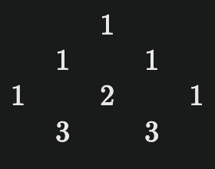
Pascal Triangle
Pascal's Triangle is a triangular array of numbers where each number is the sum of the two directly above it. It begins with a single "1" at the top. The rows correspond to the coefficients of the binomial expansion.
The nn-th row represents the coefficients of (a+b)n(a+b)n
the triangle was named after Blaise Pascal, though it was studied in other cultures, such as by Chinese mathematician Yang Hui and Indian scholars, centuries before Pascal. Its applications extend across mathematics and computer science, including solving binomial expansions, calculating combinations in probability, and identifying number sequences like powers of 2 and triangular numbers. It also aids in algorithms related to dynamic programming and combinatorial problems. Patterns in the triangle can even help discover prime numbers and connections to the Fibonacci sequence, making it a versatile tool in various fields.

Slide 32
Pascal Triangle
Pascal's Triangle has numerous applications across various fields. In probability theory, it helps determine outcomes in scenarios with two results, such as coin tosses. In combinatorics, it facilitates counting combinations and arrangements, allowing for efficient calculations of how many ways to choose kk items from nn. It also assists in algebra for binomial expansions, where each number corresponds to coefficients in polynomial expressions. Additionally, Fibonacci numbers can be derived from specific diagonals in Pascal's Triangle, linking it to number theory. In computer science, algorithms for generating combinations often utilize principles from this triangle for efficiency. Furthermore, it plays a role in game theory and statistics by aiding in evaluating possible outcomes and calculating distributions for binomially distributed random variables. Overall, Pascal's Triangle serves as a foundational concept that demonstrates its versatility and importance in both theoretical and practical applications.

Slide 33
Salesforce
Salesforce is a leading cloud-based customer relationship management (CRM) platform that enables businesses to efficiently manage customer interactions, sales processes, and marketing efforts. Initially designed for sales automation, Salesforce has expanded its capabilities to encompass a wide range of functionalities that support various business needs across industries. The platform offers comprehensive tools for contact and account management, opportunity tracking, lead management, and sales forecasting, allowing organizations to streamline their sales processes and enhance productivity.

Slide 34
Types of Salesforce
Sales Cloud: This flagship solution focuses on sales automation, enabling organizations to manage their entire sales lifecycle from lead generation to deal closure. Key features include account and contact management, opportunity tracking, and sales forecasting, which help increase efficiency and drive revenue growth.
Service Cloud: Designed for customer service excellence, Service Cloud provides tools for case management, omnichannel support, and knowledge base creation. It empowers businesses to enhance customer experiences by streamlining service operations and improving agent productivity through automation and AI-driven insights.
Marketing Cloud: This platform connects companies with customers across multiple channels, allowing for personalized marketing campaigns. It includes features for email marketing, social media engagement, and customer journey mapping, enabling businesses to optimize their marketing efforts based on data-driven insights.

Slide 35
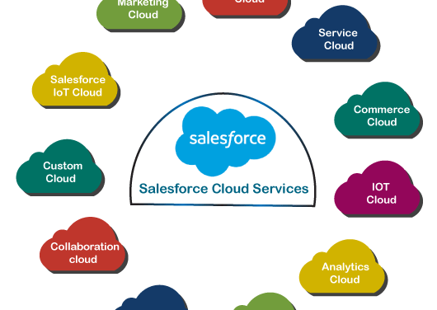
Commerce Cloud: Tailored for e-commerce businesses, Commerce Cloud provides a unified platform for managing online sales. It supports personalized shopping experiences, order management, and inventory control, helping organizations enhance their digital commerce strategies.
Experience Cloud: Formerly known as Community Cloud, Experience Cloud enables businesses to create branded online communities for customers, partners, and employees. It facilitates collaboration and engagement through customizable portals that leverage existing CRM data.
Analytics Cloud: This cloud focuses on data analysis and visualization, providing tools for predictive modeling and business intelligence. Analytics Cloud helps organizations derive actionable insights from their data to inform strategic decision - making.

Slide 36
Different Types of Charts
Bar Chart:
A bar chart uses horizontal or vertical bars to compare data across categories. The length of each bar represents the value. It's ideal for showing comparisons, such as sales by product type or population by region.
Line Chart:
A line chart connects data points with lines to show trends over time. It's useful for visualizing changes, such as stock prices or temperature fluctuations, across a continuous dataset.

Slide 37
Different Types of Charts
Histogram:
Histograms group data into intervals and display them as bars, showing the
frequency distribution of a dataset. They're often used in statistics to analyze patterns, such as test scores or age ranges.
Scatter Plot:
A scatter plot displays data points on a two-dimensional grid to illustrate
relationships or correlations between two variables. It's commonly used in
research and data analysis to identify trends or clusters.
Bubble Chart:
Similar to a scatter plot, a bubble chart uses bubbles instead of dots, where
the size of each bubble represents an additional data variable. It's effective
for multidimensional analysis, such as sales, profit, and market share.

Slide 38
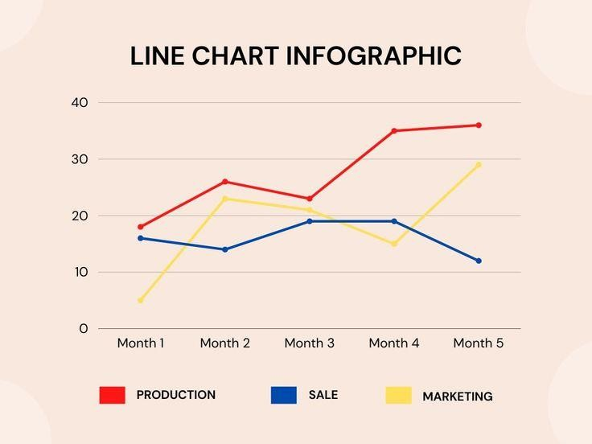
Different Graph and Line

Slide 39
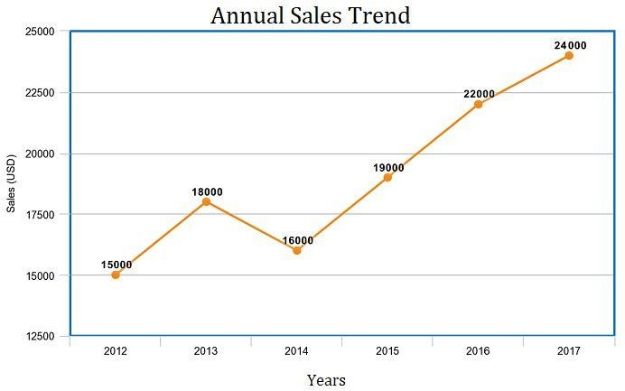
Different Graph
Line Graph:
Used to display trends over time by connecting data points with a continuous line.
Ideal for showcasing progress, such as sales growth, temperature changes, or performance metrics.
A line graph, also known as a line chart, is a type of chart used to represent data points connected by straight lines. It's commonly used to display trends over time and can illustrate changes, comparisons, and relationships between data sets

Slide 40



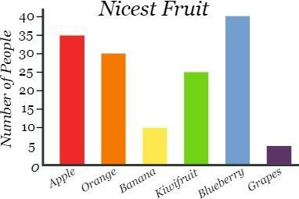
Bar Graph:
Compares discrete categories using horizontal or vertical bars.
Great for illustrating differences across groups, like sales by region or product performance
A bar graph, or bar chart, is a graphical representation used to display and compare the frequency, count, or other measures for different categories or groups. It consists of rectangular bars, where the length or height of each bar is proportional to the value it represents

Slide 41
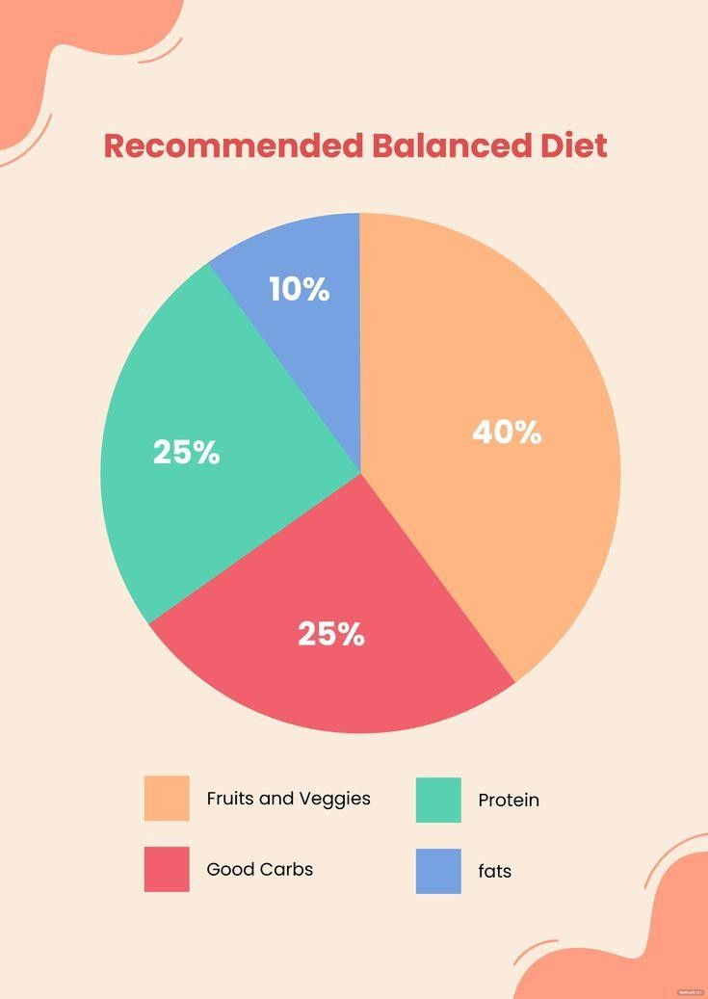
Pie Graph:
Represents proportions or percentages as slices of a circle.
Effective for visualizing part-to-whole relationships, such as market share or expense breakdowns.
A pie graph, also known as a pie chart, is a circular chart divided into sectors, each representing a proportion of the whole. It is a visual tool used to illustrate the relative sizes of parts of a dataset, making comparisons straightforward.
pie charts are best used when you want to show the parts of a whole and compare their proportions, rather than exact values. They provide a clear, concise, and aesthetically pleasing means of displaying how individual parts contribute to the whole, making them a popular choice for data visualization.

Slide 42
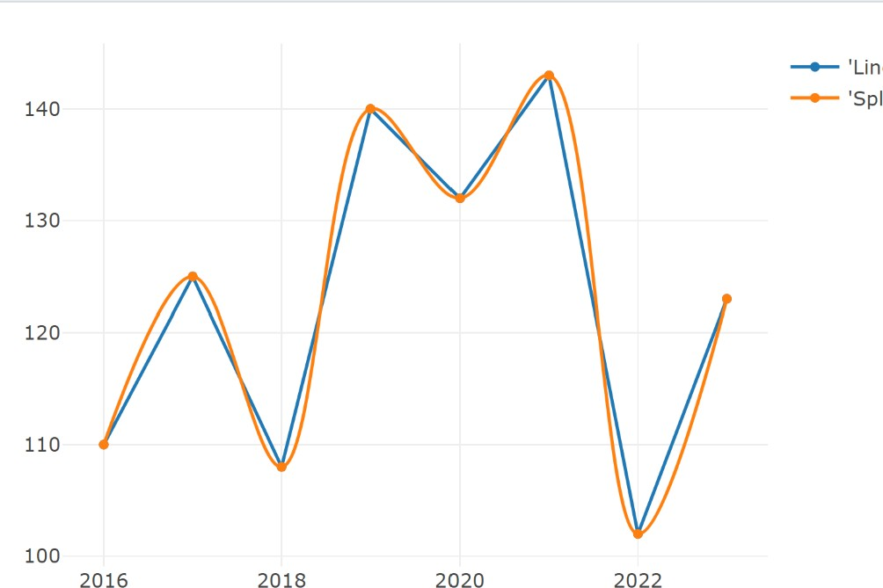

Spline Line:
A smooth curve that connects data points, providing a polished, flowing appearance.
Ideal for representing gradual trends, like user engagement over weeks.
spline line, or simply a spline, is a mathematical function used in data interpolation and smoothing. Unlike straight lines that only connect two points, splines are curved lines that pass through a series of points, creating a smooth transition between them. This makes them ideal for modeling and visualizing data where smooth curves are more appropriate than sharp angles.

Slide 43
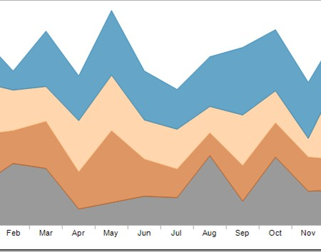
Stacked Line Graph:
Displays multiple data sets stacked on top of each other to show cumulative values.
Perfect for comparing contributions of different factors to a total, like expenses by department.
A stacked line chart, or stacked line graph, is a type of line chart used to show how individual parts contribute to the total over time. Each line represents a category, and the areas between the lines are filled to highlight the cumulative contribution of each category to the total.

Slide 44
Who Uses Google Sheets
Google Sheets is widely used across various sectors. Businesses and teams rely on it for tracking sales, managing projects, and collaborating on documents in real-time. It's especially popular among small businesses and startups for budget management and financial planning. Students and educators use it for organizing class schedules, tracking grades, and collaborating on group projects. The ease of sharing and real-time collaboration makes it an ideal tool for both high school and university students. Additionally, freelancers and entrepreneurs use Google Sheets to manage invoices, track client information, and create budgets or project timelines. The tool's mobile accessibility is also favored by freelancers for working on-the-go.

Slide 45
Why Uses Google Sheets
Real-Time Collaboration: Multiple users can work on the same document simultaneously, making teamwork and collaboration efficient and seamless.
Cost-Effective: Google Sheets is free to use with a Google account, offering businesses, students, and freelancers a reliable tool without the need for paid software.
Cloud-Based Accessibility: Google Sheets is accessible from any device with an internet connection, ensuring users can access their work from anywhere, at any time.
Integration with Google Tools: It integrates seamlessly with other Google services like Gmail, Google Docs, and Google Drive, enhancing productivity and simplifying workflows

Slide 46

What is Excel
Microsoft Excel is a powerful spreadsheet application developed by Microsoft, part of the Microsoft Office suite. It is used for organizing, analyzing, and storing data in tabular form. Excel provides users with a range of tools and functions to perform complex calculations, create visual data representations (such as charts and graphs), and manage large datasets efficiently

Slide 47
About Excel
Data Entry and Management: Allows users to input, edit, and organize data in rows and columns
.Formulas and Functions: Includes a wide range of built-in formulas and functions for mathematical, statistical, financial, and logical calculation.
Pivot Tables: Enables users to summarize and analyze large datasets by grouping and filtering information.
Charts and Graphs: Offers tools to create a variety of visual representations of data, such as line graphs, bar charts, and pie charts
.Data Analysis Tools: Includes features like data validation, conditional formatting, and advanced filtering to assist with sorting and analyzing data
Macros: Allows users to automate repetitive tasks through VBA (Visual Basic for Applications) macros.

Slide 48
Advantages and Disadvantages of Excel

Slide 49
Advantages
Versatility and Ease of Use: Excel is highly versatile, allowing users to perform various tasks such as calculations, data analysis, charting, and more within a single platform. Its intuitive interface makes it accessible to users with varying levels of expertise
Data Analysis Tools: Excel offers powerful tools for data analysis, including formulas, functions, pivot tables, and charts. These tools aid in insightful data interpretation and visualization, enabling data-driven decision-making
Collaboration and Sharing: Excel enables real-time collaboration through cloud-based platforms like OneDrive or SharePoint. It also offers features for version control and secure sharing of workbooks
Calability: Excel can handle large datasets and is adaptable for projects of various sizes, from small-scale plans to large, multi-faceted endeavors

Slide 50
Disadvantages
Version Control and Data Loss: Managing versions and tracking changes in Excel can be challenging, especially in collaborative environments. This can lead to data loss or overwritten changes, which can be significant setbacks
Frequent Updates and Inconsistencies: Frequent updates in Excel can lead to inconsistencies in formulas and layouts, causing errors and confusion when transitioning between different versions
Collaboration Challenges: While Excel allows collaboration, it can be cumbersome, especially when multiple users need to edit the same file simultaneously. Real-time collaboration is limited, and version control issues can arise
Prone to Errors: Human errors such as incorrect formulas or data input can occur, leading to inaccurate results. Detecting and rectifying these errors can be time-consuming and impact critical business processes

Slide 51
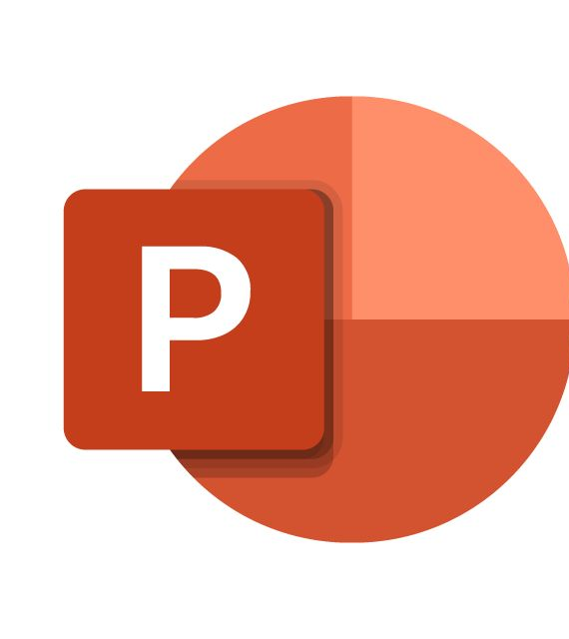
What is PowerPoint
Microsoft PowerPoint is a presentation software program developed by Microsoft. It is part of the Microsoft Office suite and is widely used for creating visual presentations, often for business, educational, and professional purposes

Slide 52
Characteristics of PowerPoint
User-Friendly Interface:-Creating a user-friendly interface in PowerPoint involves several key elements to ensure your presentation is intuitive and easy to navigate. First, maintain a clear layout by keeping it clean and organized to avoid clutter, which enhances readability. Consistent design is crucial, so use a uniform color scheme, font style, and design elements
Presentation Modes:- Normal View: This is the default editing mode where you can create and design your slides. It displays thumbnails of your slides on the left and a large view of the current slide in the main area.
Slide Show View: This mode is used to present your slides full screen. It’s ideal for delivering your presentation to an audience. You can navigate through slides using keyboard shortcuts, a mouse, or a remote.
Rich Multimedia Support:-Rich multimedia support in presentations and documents refers to the ability to incorporate various types of media, such as images, audio, video, and animations, to enhance the content and make it more engaging. Microsoft PowerPoint and other similar tools offer robust multimedia support, providing numerous benefit

Slide 53
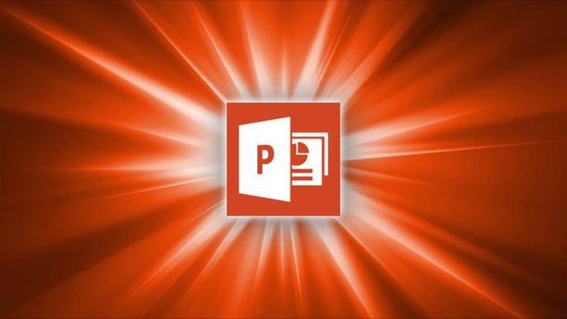
Advantages and Disadvantages of PowerPoint

Slide 54
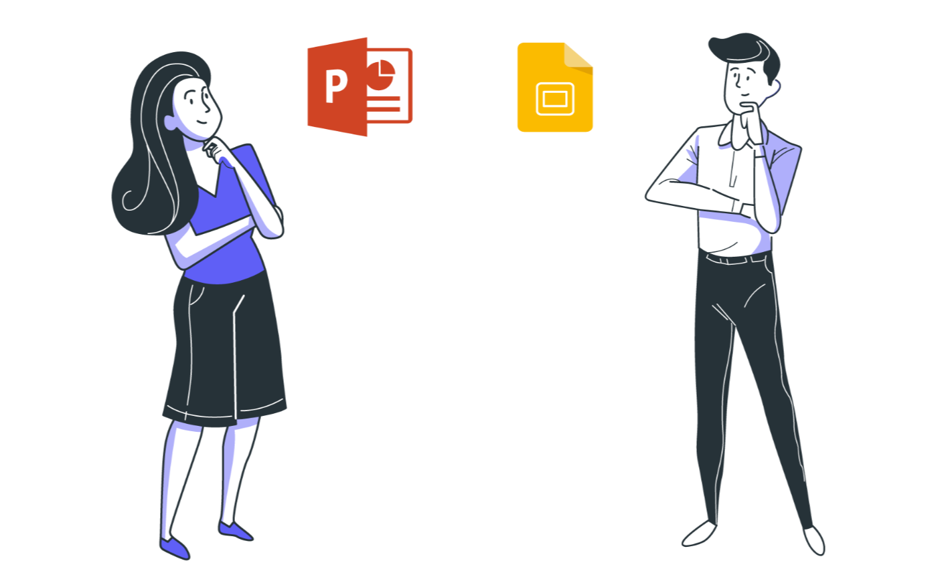
Advantages
Slide Transitions and Animations:- PowerPoint offers various slide transitions and animation effects to enhance the visual appeal and flow of presentations.
User-Friendly Interface:- PowerPoint's intuitive design and layout make it accessible for users of all skill levels, enabling them to create professional presentations with ease.
integration with Other Microsoft Office Apps:- Seamless integration with Word, Excel, and other Microsoft Office applications enables easy import and export of data and content.
Versatile Templates :-It provides a wide range of templates and themes, allowing users to start with a professional design and customize it to fit their specific needs.
collaboration Features:- Multiple users can work on the same presentation simultaneously

Slide 55

Disadvantages
Complexity for Beginners:- New users might find it challenging to navigate the numerous features and options available in PowerPoint.
Compatibility Issues:- While PowerPoint is widely used, there can still be compatibility issues when sharing files with users who use different software or versions.
Potential for Technical Problems:- Issues like software crashes or compatibility problems with other devices can disrupt presentation
Overuse of Effect:- The abundance of animations and transitions can lead to overuse, potentially distracting from the content rather than enhancing it.

Slide 56
What is Size of Data
Average File Size: A typical PowerPoint presentation with text, images, and basic formatting generally ranges from 1 to 5 MB. This size ensures that the file is easy to share and doesn't slow down the software. Simple presentations with minimal visual elements tend to stay on the lower end, while those incorporating more images and charts can be slightly larger. Keeping the file size manageable helps in smoother performance and easier dissemination through email or cloud services

Slide 57

What is Size of Data
large Presentations: When presentations include high-resolution images, videos, and complex animations, the file size can increase significantly, sometimes reaching up to 100 MB or more. These elements enhance the visual appeal and effectiveness of the presentation but require more storage space and can slow down PowerPoint. Large presentations are often used in professional settings where impactful visual communication is necessary. To handle these sizes, it's advisable to use advanced file compression techniques and ensure powerful hardware to manage the file smoothly.

Slide 58

What is Size of Data
File Size Limits: PowerPoint doesn’t impose strict file size limits, but very large files (e.g., over 1 GB) can cause performance issues and slow down the application. Such large files may be challenging to share, especially over email or less powerful networks. They may also lead to longer loading times and potential crashes, especially on older or less powerful hardware. To avoid these problems, it’s essential to optimize the content by compressing images, reducing video quality, and eliminating unnecessary media

Slide 59

Optimization Tips
To manage PowerPoint file sizes effectively, it's crucial to optimize various elements within the presentation. Compressing images and using lower resolutions can significantly reduce file size without compromising too much on quality. Avoid embedding fonts unless necessary, and instead use standard fonts available across most systems. For videos, consider linking rather than embedding them, and use compression tools to reduce their size. These practices not only make the file more manageable but also enhance overall performance.

Slide 60

Storage Considerations
Large PowerPoint files require more storage space and can be cumbersome to share or upload, especially through email or less robust cloud services. It's important to consider storage limitations and sharing capabilities when designing presentations. Using cloud storage solutions like OneDrive or SharePoint can mitigate these issues by providing ample space and easy sharing options. This is especially useful in collaborative environments where multiple users need access to the same presentation

Slide 61
What are Values?
Values are fundamental beliefs or standards that guide behaviors, decisions, and actions. They are core principles that shape our perspectives and priorities, influencing how we interact with the world. Values can be ethical or moral, such as honesty, integrity, and respect, or they can be more personal preferences, like ambition, creativity, and independence. These core principles are often developed early in life through family, culture, education, and personal experiences, and they evolve over time as individuals grow and encounter new situations. Values serve as a compass, helping individuals navigate various aspects of life by providing a sense of direction and purpose.

Slide 62
Why We Use Values
Values are used as a framework for decision-making and behavior. They help individuals and organizations determine what is important, acceptable, and desirable. For example, a person who values honesty will strive to be truthful in their interactions, while a company that values innovation will prioritize creativity and forward-thinking. By adhering to their values, individuals can make consistent and congruent choices, leading to a more authentic and satisfying life. For organizations, values establish a foundational culture and guide business practices, employee behavior, and customer interactions. They foster trust and loyalty among stakeholders, ultimately contributing to long-term success

Slide 63
Importance of Values
Values are crucial because they provide a foundation for behavior and decision-making, promoting consistency and integrity. For individuals, having clear values helps in making choices that align with their true self, reducing internal conflicts and enhancing overall well-being. In relationships, shared values can strengthen bonds and foster mutual respect and understanding. In the workplace, values shape the culture, influence employee behavior, and drive organizational success. They serve as a benchmark for performance and decision-making, ensuring that actions are aligned with the organization’s mission and vision. Moreover, values foster a sense of identity and belonging, both individually and collectively, contributing to personal and societal growth

Slide 64
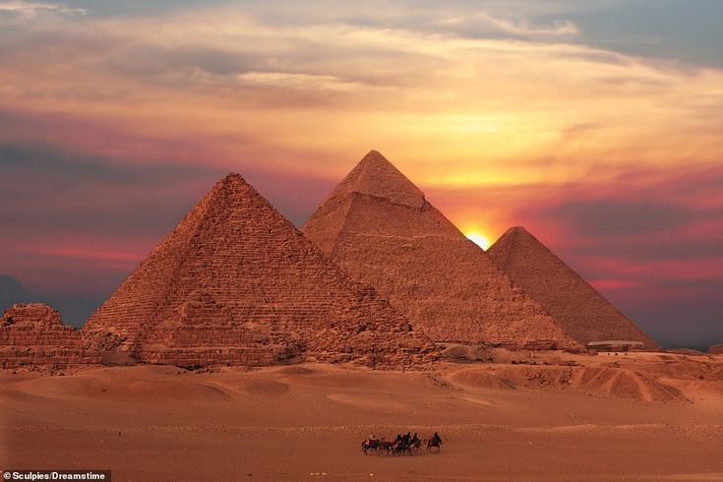
Lets take dive in old days when the pyramid were made

Slide 65
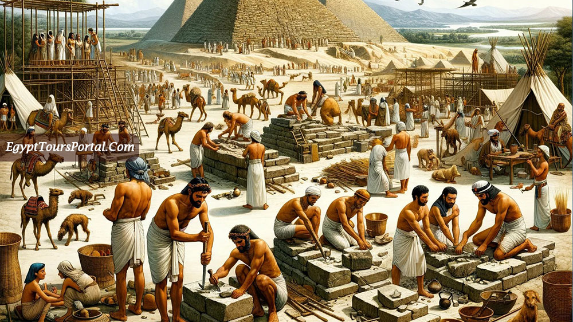
What are pyramids?
Pyramids are monumental structures with a square or triangular base and four triangular sides that converge at a single point at the top. Built primarily by ancient civilizations such as the Egyptians, they served as tombs for pharaohs and noble individuals. Pyramids symbolize religious and ceremonial significance, reflecting the civilization’s architectural prowess and spiritual beliefs. The most renowned pyramids are those in Giza, including the Great Pyramid of Khufu. These structures were constructed using massive stone blocks and demonstrate the ancient builders' sophisticated understanding of geometry, alignment, and construction techniques. Pyramids have also been found in other parts of the world, such as Central America and Sudan, each serving similar purposes but with distinct cultural and architectural styles.

Slide 66
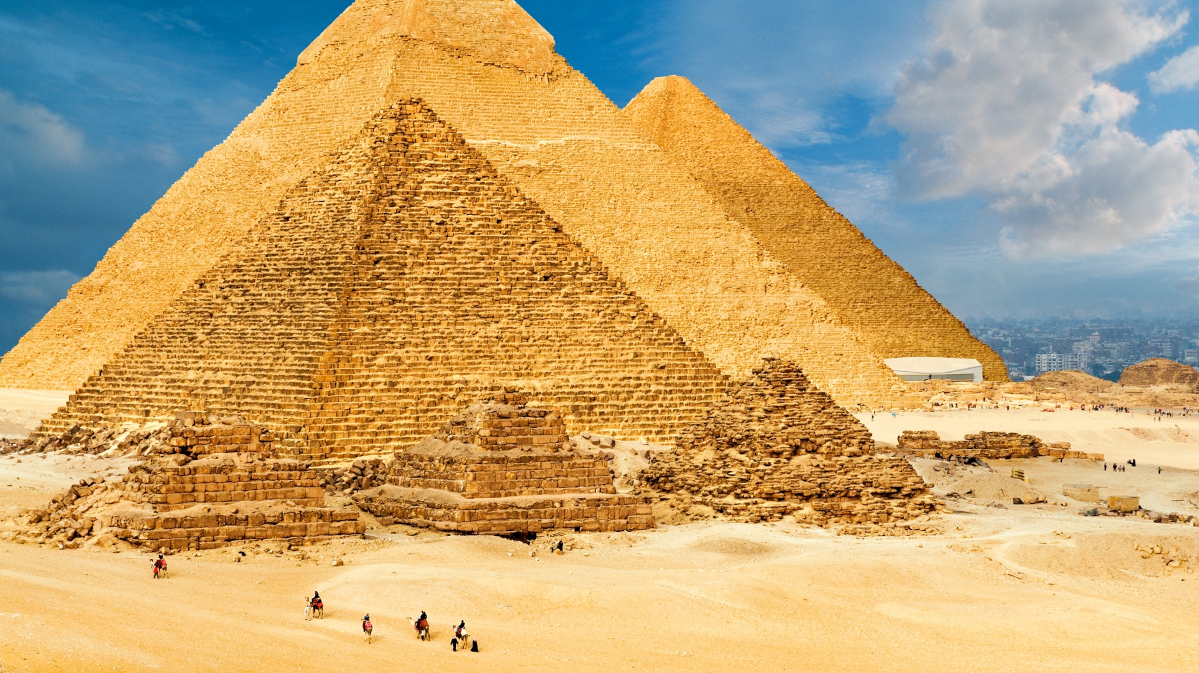
Why were pyramids made?
Pyramids were primarily built as tombs for pharaohs and significant individuals, ensuring their safe journey to the afterlife. The design of the pyramids, particularly their alignment with celestial bodies, reflected the Egyptians' belief in the afterlife and the importance of the pharaohs' divine status. These structures were intended to protect the body and belongings of the deceased, providing a secure resting place that would stand the test of time. Additionally, pyramids served as monumental representations of the power and wealth of the rulers who commissioned them, showcasing their ability to mobilize resources and labor. They also played a role in religious and ceremonial activities, with their grand design reflecting the civilization's architectural and engineering achievement

Slide 67
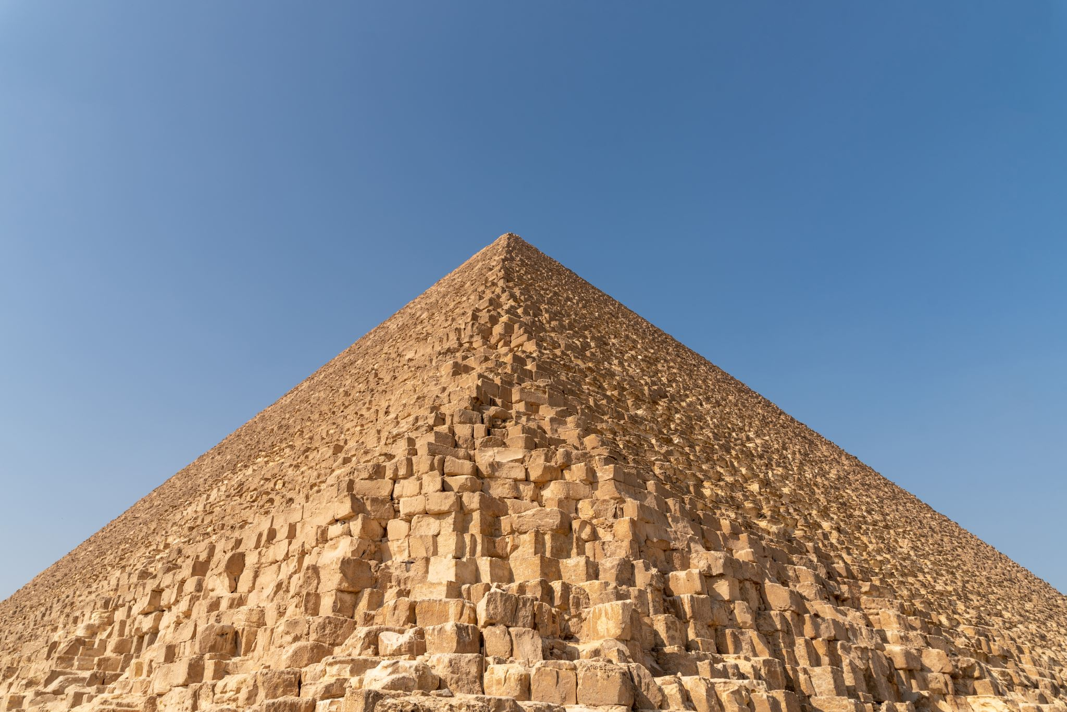
Additionally, pyramids served as monumental representations of the power and wealth of the rulers who commissioned them, showcasing their ability to mobilize resources and labor. They also played a role in religious and ceremonial activities, with their grand design reflecting the civilization's architectural and engineering achievement

Slide 68
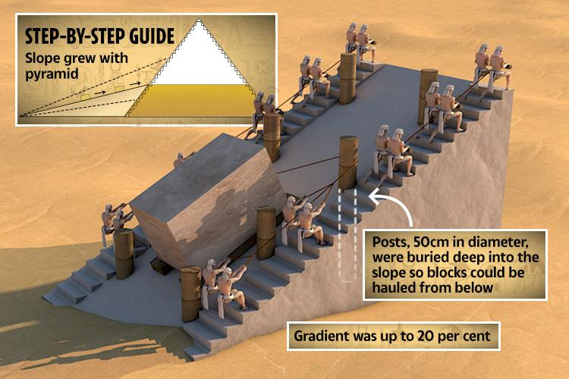
How were pyramids made?
Pyramids were constructed using massive stone blocks, quarried locally and transported to the construction site. The process involved cutting and shaping the stones with primitive tools such as copper chisels, wooden mallets, and stone hammers. Once transported, the stones were assembled using ramps, which could be straight, zigzagging, or spiral. These ramps allowed workers to move the heavy blocks up to the higher levels of the pyramid. The precision in aligning the pyramids with celestial bodies suggests advanced knowledge of astronomy and geometry. Workers would carefully measure and place each stone to ensure the structure's stability and symmetry. The construction required a large workforce, including skilled laborers, engineers, and slaves, coordinated to achieve these monumental feats

Slide 69
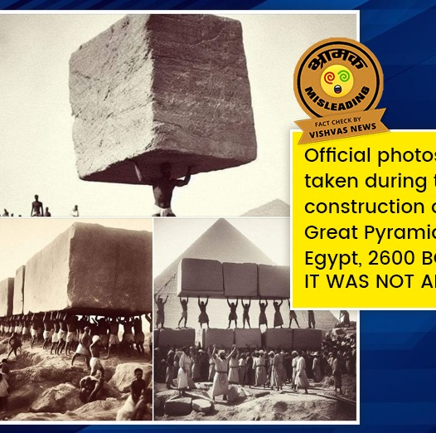
What were the past probabilities regarding pyramid construction methods?
Several theories have been proposed about the methods used to construct pyramids, given the lack of definitive records. One popular theory is the use of straight or spiral ramps to transport the massive stones to higher levels. Another hypothesis involves the use of counterweights and levers to lift the stones. Some researchers suggest that a combination of ramps and mechanical devices was employed to achieve the precise placement of the stones. There is also speculation about the organization and management of the workforce, including skilled laborers, engineers, and slaves, and the logistics involved in sourcing and transporting materials. Despite various theories, the exact methods remain a subject of ongoing research and debate, showcasing the ingenuity and resourcefulness of ancient builders.

Slide 70
How did they measure all the things during construction?
Ancient builders measured using simple yet effective tools such as ropes, plumb bobs, and sighting instruments. Ropes were used for measuring distances and ensuring straight lines, while plumb bobs helped maintain vertical alignment. Sighting instruments, like the groma and dioptra, were used for precise alignment and level. The builders had a sophisticated understanding of geometry, which allowed them to calculate angles and distances accurately. They also used astronomical observations to align the pyramids with celestial bodies, ensuring precision in their construction. The use of these tools and techniques reflects the advanced mathematical and engineering knowledge of the ancient Egyptians, enabling them to construct monumental structures that have stood the test of time

Slide 71

What are color codes?
Color codes are alphanumeric representations used to specify and communicate colors in digital applications and design. They ensure accuracy and consistency across different platforms and media. Hexadecimal codes are six-digit codes preceded by a hash (#),
e.g., #FFFFFF for white. RGB codes use three values representing Red, Green, and Blue intensities,
e.g., RGB(255, 0, 0) for red. CMYK codes are used in printing, representing Cyan, Magenta, Yellow, and Key (black) with percentages, e.g., CMYK(0%, 100%, 100%, 0%) for red. HSL codes denote Hue, Saturation, and Lightness, e.g., HSL(0, 100%, 50%) for red.
Pantone codes are part of a standardized color matching system widely used in various industries. These codes help designers maintain color accuracy and consistency in digital and print media

Slide 72
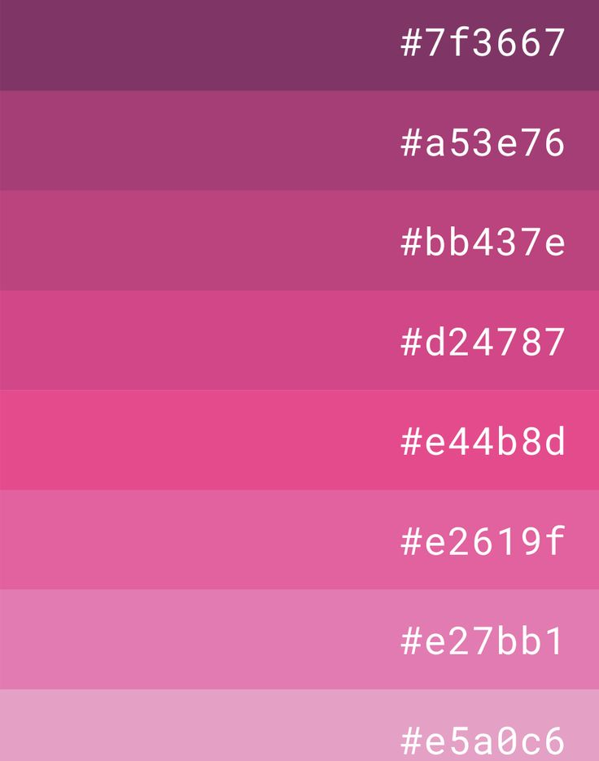
Explain the significance of hexadecimal colour codes in web design. How are they structured and used to represent colours?
Hexadecimal colour codes are essential in web design for precise colour specification. Structured as six-digit combinations, they use a base-16 numbering system with values ranging from 00 to FF, corresponding to the intensity of Red, Green, and Blue (RGB). For example, #FF5733 represents a shade of orange. The first two digits indicate red intensity, the next two green, and the last two blue. Hex codes provide a standardized way to ensure colour consistency across different browsers and devices. They are easy to use and widely supported in HTML, CSS, and other web technologies. Designers and developers rely on hex codes to achieve specific colour schemes and enhance the visual appeal of web pages. Their concise format makes them ideal for embedding in code and quickly adjusting colours during the design process

Slide 73
Describe the RGB colour model. How do the values of red, green, and blue influence the final colour displayed on a digital screen? Provide an example with RGB values
The RGB color model is based on the additive color theory, where color are created by combining red, green, and blue light in various intensities. Each color component is represented by a value between 0 and 255. The final color displayed on a digital screen results from the combination of these three components. For example, RGB(255, 0, 0) produces pure red, while RGB(0, 255, 0) results in pure green. Mixing these colors creates other colors; combining equal intensities of red and green, such as RGB(255, 255, 0), produces yellow. Lower values create darker colors, while higher values create lighter ones. The RGB model is widely used in digital displays because it aligns with how screens emit light, making it a fundamental concept in design and imaging

Slide 74

RGB color

Slide 75
Compare and contrast the RGB and CMYK color models. In what scenarios would each model be more appropriate to use, and why?
The RGB color model is used for digital displays, while the CMYK model is used for color printing. RGB is additive, combining red, green, and blue light to create colors, making it ideal for screens and digital devices. CMYK, on the other hand, is subtractive, using cyan, magenta, yellow, and black inks to absorb light and produce colors, suitable for printed materials. RGB offers a broader color range and is used in web design, photography, and digital art. CMYK is preferred for brochures, posters, and other printed media to ensure color accuracy and consistency. Understanding both models is crucial for designers to produce accurate colors across different media

Slide 76
What is the HSL color model? Explain how hue, saturation, and lightness work together to define a color. Illustrate with an example.
The HSL color model stands for Hue, Saturation, and Lightness. Hue represents the color type (e.g., red, blue) as a degree on the color wheel from 0 to 360. Saturation indicates the intensity or purity of the color, ranging from 0% (gray) to 100% (full color). Lightness refers to the brightness of the color, from 0% (black) to 100% (white). Together, these components define a color’s appearance. For example, HSL(240, 100%, 50%) represents a pure, medium-blue color. Adjusting saturation and lightness values changes the color's vibrancy and shade, making HSL useful for creating various tones and tints in design.

Slide 77
What are some common software tools and shortcuts that designers and developers use to quickly find and apply color codes in their projects?
Designers and developers use various tools and shortcuts to efficiently manage color codes. Adobe Color Wheel is an online tool that allows users to create and save color palettes. It provides hex, RGB, and CMYK values for easy application. ColorZilla is a browser extension that offers a color picker, gradient generator, and color history. Users can quickly identify color on web pages and retrieve their codes. Both tools streamline the design process by providing quick access to precise color information, enhancing productivity and ensuring color consistency across projects

Slide 78
Hexadecimal Color Codes
Hexadecimal color codes are six-digit codes, often used in web design, that represent colors in RGB format. The code starts with a hash (#) followed by six characters, such as #FFFFFF for white or #000000 for black. Each pair of characters represents the intensity of red, green, and blue, respectively.

Slide 79
RGB Color Codes
RGB color codes use three numerical values to represent colors in terms of red, green, and blue light. Each value ranges from 0 to 255. For example, RGB(255, 0, 0) represents red. These codes are widely used in digital displays and design

Slide 80

CMYK Color Codes
CMYK stands for Cyan, Magenta, Yellow, and Key (black). These color codes are used in printing, with each component represented as a percentage from 0% to 100%. For example, CMYK(0%, 100%, 100%, 0%) represents red. This model is subtractive, meaning colors are created by removing light

Slide 81
HSL Color Codes
HSL stands for Hue, Saturation, and Lightness. Hue is represented as a degree on the color wheel from 0 to 360, while saturation and lightness are percentages from 0% to 100%. For example, HSL(240, 100%, 50%) represents a pure blue color

Slide 82

Pantone Color Codes
Pantone color codes are part of the Pantone Matching System (PMS), used for ensuring color consistency in various industries. Each color has a unique code, such as Pantone 294 C. Pantone is widely used in printing, fashion, and product design to match specific shades accurately

Slide 83
Yassification: A Trend in Modern Language

Slide 84

Definition:- Yassification
Yassification is a term that has emerged from internet culture, particularly on platforms like TikTok and Twitter. It refers to the process of transforming someone's appearance to a highly glamorous, exaggerated, and often hyper-feminine look using various photo editing tools and filters. The term "yass" itself is derived from queer culture, where it is used as an exclamation of approval or excitement, and "yassification" takes it a step further by implying a dramatic makeover.
The yassification trend often involves applying heavy makeup, smoothing skin textures, enhancing facial features, and adding vibrant colors to create an almost surreal version of the original image. Popular apps and software like Facetune and Photoshop are commonly used for these transformations. The results are frequently shared on social media, sometimes with a humorous or ironic twist, as a commentary on societal beauty standards and the extremes of digital modification.
This phenomenon reflects broader discussions about beauty, identity, and the influence of digital technology on self-presentation. It satirizes the lengths to which people go to curate their online personas and highlights the gap between natural appearances and digitally altered perfection. Ultimately, yassification is both a celebration of creativity and a critique of unrealistic beauty ideals.

Slide 85

Cultural Context
Yassification mirrors society's fascination with persona-building and the ways individuals curate their identities online. It plays into the broader cultural narrative of presenting an idealized self to the world, often blurring the lines between reality and hyperreality
Emerging in 2021, yassification reflected a growing acceptance of hyperreality in aesthetics on social media. This trend highlighted the shift towards highly stylized and exaggerated forms of beauty, often achieved through digital enhancements and filters. Yassification involves the use of photo editing tools to dramatically alter a person’s appearance, adding elements like heavy makeup, flawless skin, and vibrant colors to create an almost surreal version of the original image. This process not only transforms the physical look but also constructs an idealized persona that aligns with modern beauty standard

Slide 86
Yassification became evident in memes and viral videos where users would humorously yassify celebrities and characters. This trend involved using photo editing tools to add exaggerated makeup, perfect skin, and glamorous effects to well-known figures, often with a playful or satirical twist. The process of yassification quickly gained popularity on social media platforms like TikTok and Twitter, where users enjoyed sharing their humorous and over-the-top transformations.
Examples in Media
hows like RuPaul's Drag Race played a significant role in popularizing these aesthetics. The show, which celebrates drag culture and emphasizes creativity, extravagance, and self-expression, resonated with a broad audience and captured the public imagination. Contestants on the show often undergo dramatic transformations, embodying the essence of yassification through their elaborate costumes, makeup, and performances.

Slide 87

Impact on Social Media
Yassification reflects an evolving landscape of identity representation, where individuals explore and manipulate their digital personas. The phenomenon underscores the growing acceptance of hyperreality in aesthetics, as people increasingly blur the lines between their real and virtual selves. It also highlights the influence of digital technology on shaping beauty standards and self-image, demonstrating how easily identities can be transformed and curated online
The yassification trend has significantly fueled engagement on platforms like TikTok and Instagram, where users leverage this exaggerated and glamorous style to enhance their online presence. By applying filters and editing tools to create hyper-feminine, polished versions of themselves or famous personalities, users participate in a broader cultural shift towards playful and satirical self-presentation. This trend not only amuses but also attracts attention, leading to higher interaction rates on social media posts.

Slide 88
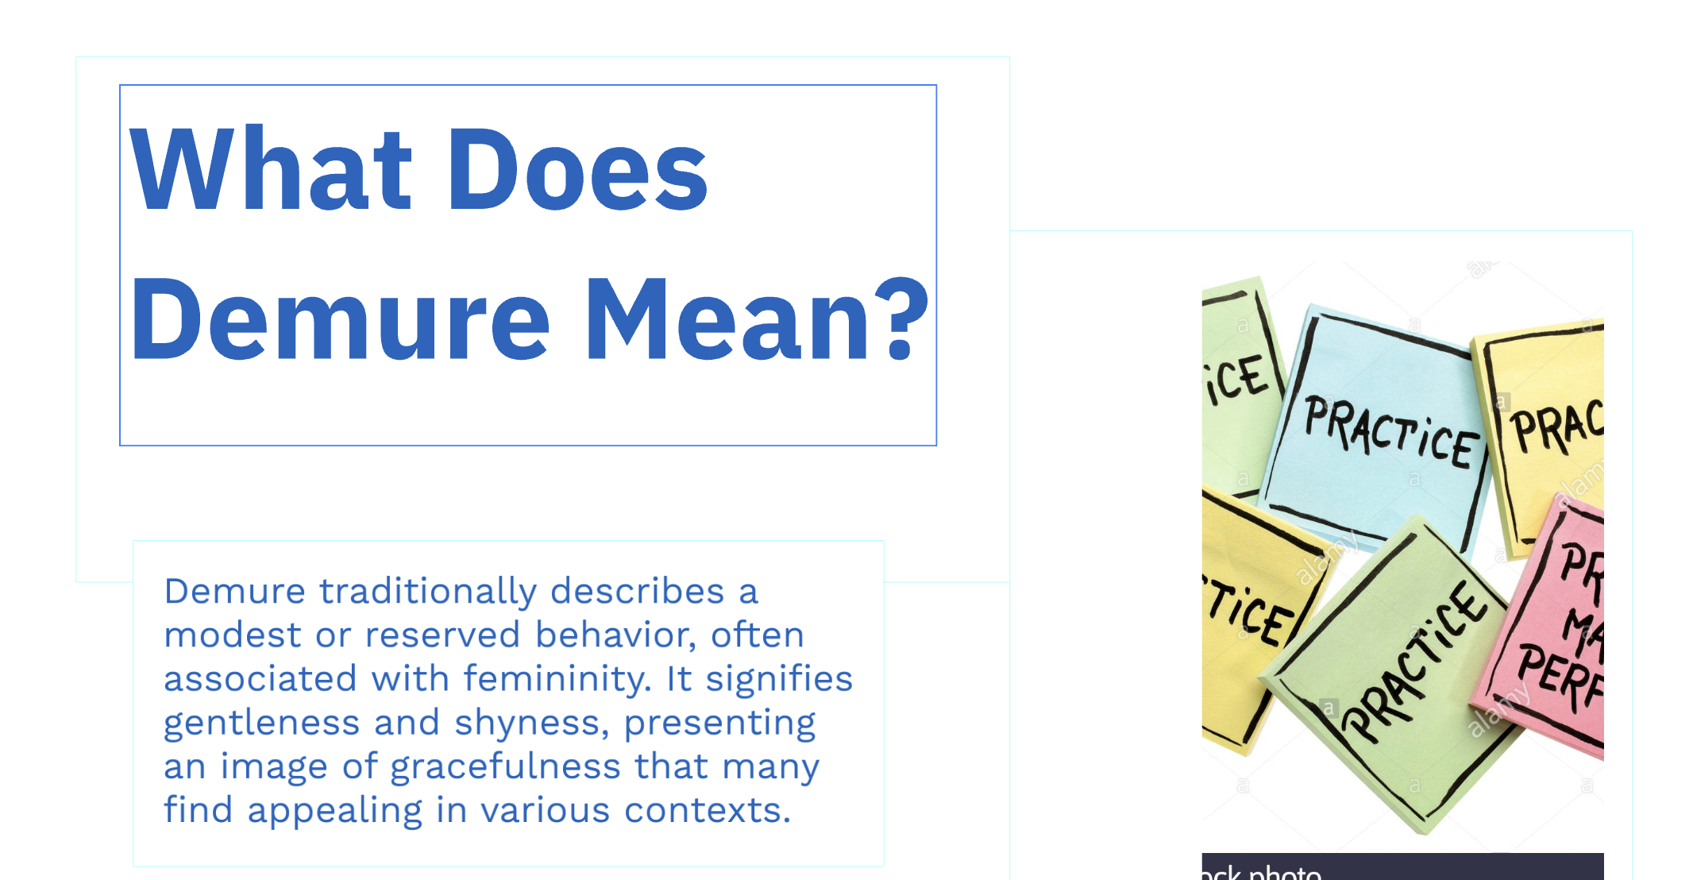

Slide 89
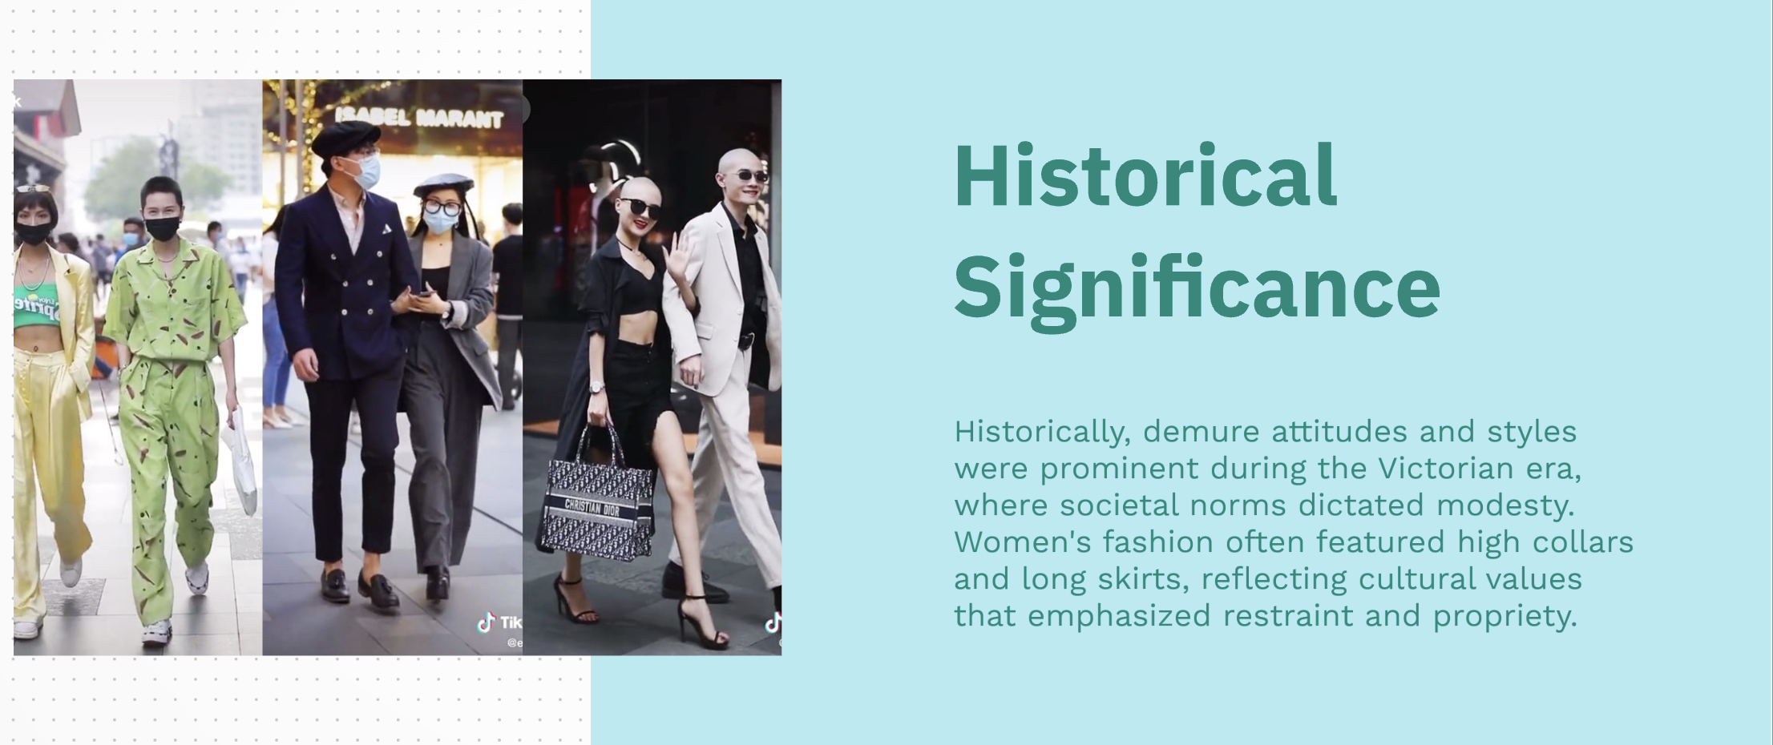

Slide 90
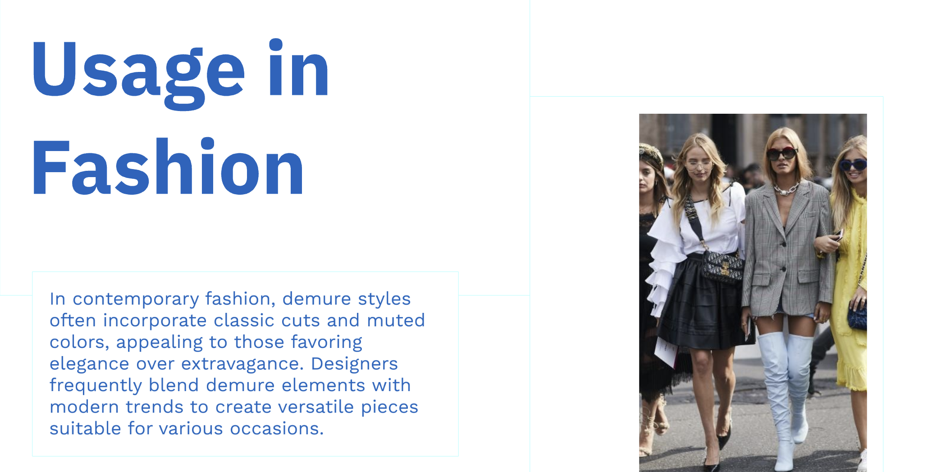

Slide 91
What is Salesforce?
Overview of salesforce
Integrates with other business tools like email and social media.
Enables personalized customer experiences.

Slide 92
What is Salesforce?
Overview of salesforce
Facilitates communication across departments.
Offers a range of features like lead management and account tracking.
Scalable for small businesses to large enterprises.

Slide 93
Different types of Salesforce
2. Service Cloud
Optimizes customer service and support operations.
Includes tools for case management, ticketing, and resolution.
Integrates with social media platforms to manage customer queries.

Slide 94
Different types of Salesforce
2. Service Cloud
Provides real-time collaboration between agents.
Automates common support tasks using AI.

Slide 95
Different types of Salesforce
Service Cloud
Enables knowledge base creation for customers.
Personalizes the service experience for each client.
Includes analytics to track service performance.

Slide 96
Different types of Salesforce
Service Cloud
Centralizes customer information for better issue resolution.
Helps reduce customer churn by improving support.

Slide 97
Different types of Salesforce
Marketing Cloud
Used for automating and managing marketing campaigns.
Includes tools for email marketing, social media management, and advertising.
Provides analytics to measure marketing campaign effectiveness.

Slide 98
Different types of Salesforce
Marketing Cloud
Tracks customer journeys and behaviors for personalized marketing.
Integrates with other Salesforce products to enhance data insights.

Slide 99
Different types of Salesforce
Marketing Cloud
Supports cross-channel marketing for a cohesive strategy.
Uses AI to predict trends and optimize campaigns.
Improves lead generation and conversion rates.

Slide 100
Different types of Salesforce
Marketing Cloud
Provides tools for segmenting audiences based on behavior.
Improves brand engagement through personalized outreach.

Slide 101
Different types of Salesforce
Commerce Cloud
E-commerce platform integrated with Salesforce CRM.
Helps create personalized shopping experiences for customers.
Integrates with mobile and social commerce platforms.

Slide 102
Different types of Salesforce
Commerce Cloud
Manages online sales channels and customer interactions.
Optimizes product recommendations based on past purchases.

Slide 103
Different types of Salesforce
4. Commerce Cloud
Provides analytics on customer behavior and trends.
Customizable storefronts for diverse customer bases.
Supports order management, inventory tracking, and fulfillment.

Slide 104
Different types of Salesforce
4. Commerce Cloud
Integration with marketing tools for targeted advertising.
Improves conversion rates and customer satisfaction.

Slide 105
Different types of Salesforce
5. Community Cloud
Enables the creation of branded online communities.
Provides a platform for customer, partner, or employee collaboration.
Facilitates knowledge sharing and peer support.

Slide 106
Different types of Salesforce
5. Community Cloud
Supports customizable forums and discussion groups.
Integrates with Salesforce CRM for better data insights.

Slide 107
Different types of Salesforce
5. Community Cloud
Improves customer engagement and loyalty through collaboration.
Mobile-friendly for easy access on any device.
Supports custom branding and design.

Slide 108
Different types of Salesforce
5. Community Cloud
Tracks engagement metrics to measure community success.
Allows real-time feedback and collaboration.

Slide 109
Different Types of Charts
Pie Chart, Bar Chart, Line Chart, and More
Pie Chart: Shows proportions of a whole.
Bar Chart: Represents categorical data with rectangular bars.
Line Chart: Displays trends over time or continuous data.

Slide 110
Different Types of Charts
Pie Chart, Bar Chart, Line Chart, and More
Scatter Plot: Shows the relationship between two variables.
Area Chart: Emphasizes magnitude of change over time.

Slide 111
Different Types of Charts
Pie Chart, Bar Chart, Line Chart, and More
Histogram: Displays frequency distribution of data.
Bubble Chart: Plots data points as bubbles of varying size.
Radar Chart: Compares multivariate data in a circular graph.

Slide 112
Different Types of Charts
Pie Chart, Bar Chart, Line Chart, and More
Gantt Chart: Visualizes project timelines.
Heatmap: Shows data values using color coding.

Slide 113
Different Types of Charts
1. Pie Chart
Description: Shows proportions of a whole.
Represents data as slices of a circle.
Each slice corresponds to a category.
Ideal for showing percentage-based data.

Slide 114
Different Types of Charts
1. Pie Chart
Best used for comparing parts to the whole.
Clear when there are 3-5 categories; too many categories can be confusing.

Slide 115
Different Types of Charts
2. Bar Chart
Description: Represents categorical data with rectangular bars.
Each bar represents a category.
Bar length shows the value of the category.
Can be vertical or horizontal.

Slide 116
Different Types of Charts
2. Bar Chart
Suitable for comparing multiple categories.
Useful for discrete data and can show large differences between categories.

Slide 117
Different Types of Charts
3. Line Chart
Description: Displays trends over time or continuous data.
Used to show changes over periods (time, distance, etc.).
Connects data points with a line.
Ideal for tracking progress or trends.

Slide 118
Different Types of Charts
3. Line Chart
Clear representation of increases or decreases over time.
Works well for time-series data.

Slide 119
Different Types of Charts
4. Scatter Plot
Description: Shows the relationship between two variables.
Data points are plotted on two axes.
Helps identify correlations between variables.

Slide 120
Different Types of Charts
4. Scatter Plot
Useful for showing patterns, trends, or outliers.
Does not show the relationship between categories, but between continuous variables.
Ideal for scientific and statistical analysis.

Slide 121
Different Types of Charts
5. Area Chart
Description: Emphasizes magnitude of change over time.
Similar to line charts, but the area beneath the line is filled in.
Good for showing cumulative totals.

Slide 122
Different Types of Charts
5. Area Chart
Emphasizes the volume of changes over time.
Shows the overall trend and proportionally represents changes.
Useful for visualizing part-to-whole relationships.

Slide 123
Different Types of Charts
6. Histogram
Description: Displays frequency distribution of data.
Used to represent the distribution of numerical data.
Breaks data into intervals or bins.

Slide 124
Different Types of Charts
6. Histogram
Height of bars shows the number of data points in each bin.
Useful for identifying patterns like normal distributions.
Ideal for showing the spread and frequency of data.

Slide 125
Different Types of Charts
7. Bubble Chart
Description: Plots data points as bubbles of varying size.
Combines the features of a scatter plot with an additional dimension represented by bubble size.
Useful for visualizing three variables at once.

Slide 126
Different Types of Charts
7. Bubble Chart
Larger bubbles represent higher values.
Ideal for showing data points with varying significance.
Often used in market analysis and business applications.

Slide 127
Different Types of Charts
8. Radar Chart
Description: Compares multivariate data in a circular graph.
Displays data on axes that radiate from a central point.
Ideal for comparing multiple variables at once.

Slide 128
Different Types of Charts
8. Radar Chart
Each axis represents a different variable.
Points are connected to form a polygon, helping visualize strengths and weaknesses.
Useful in performance analysis and product comparison.

Slide 129
Different Types of Charts
9. Gantt Chart
Description: Visualizes project timelines.
Represents tasks along a timeline.
Each task is shown as a horizontal bar, with its length proportional to the duration.
Useful for managing project schedules.
Helps track progress and dependencies between tasks.
Commonly used in project management.

Slide 130
Different Types of Charts
10. Heatmap
Description: Shows data values using color coding.
Uses color to represent values in a matrix format.
Ideal for showing intensity or frequency.
Colors provide an intuitive way to interpret data.
Often used in website analytics or geographical data visualization.
Best for visualizing large datasets with multiple variables.

Slide 131
Difference Between Graph and Line
Graph vs. Line Chart
Graph: General term for visual representations of data.
Can represent various types of data (bar, pie, etc.).
Line Chart: A specific type of graph showing trends over time.
Uses points connected by lines to represent data changes.
More suited for continuous data analysis..

Slide 132
Difference Between Graph and Line
Graph vs. Line Chart
Line charts show the relationship between two variables.
Graphs can represent multiple data series or types.
Line charts emphasize patterns in data over intervals.
Graphs are more versatile and can include multiple axes.
Line charts focus on smooth trends in data

Slide 133
Characteristics of Google Sheets
Accessibility and Cloud-Based Nature
Google Sheets is cloud-based, accessible anywhere with an internet connection.
No installation required; just a Google account.
All data saved in Google Drive.
Real-time synchronization across devices.
Offline mode available via mobile apps.

Slide 134
Characteristics of Google Sheets
Accessibility and Cloud-Based Nature
Cross-platform compatibility (Windows, macOS, mobile).
Automatic updates without user intervention.
No need for manual backups.
Secure and encrypted data storage.
Access data from any browser or device.

Slide 135
Characteristics of Google Sheets
Collaboration and Sharing Features
Share documents with individuals or groups.
Assign specific roles: View, Comment, Edit.
Real-time collaborative editing and commenting.
Revision history for tracking changes.
Email notifications for changes made.

Slide 136
Characteristics of Google Sheets
Collaboration and Sharing Features
Easy sharing via links.
Allow others to suggest edits.
Commenting on cells for feedback.
Integrates with Google Meet for team meetings.
Permissions can be set on file, sheet, or range level.

Slide 137
Characteristics of Google Sheets
Integration with Google Apps
Google Sheets integrates with Google Drive, Docs, and Slides.
Import data from Google Forms into Sheets.
Sync with Google Calendar for project scheduling.
Link data from Google Docs or Slides into Sheets.
Easily share Sheets through Gmail.

Slide 138
Characteristics of Google Sheets
Integration with Google Apps
Use Google Apps Script for automation.
Embed Sheets into websites or blogs.
Use Google Keep for note-taking alongside Sheets.
Combine Sheets with Google Analytics for data insights.
Seamless integration with Google Meet for collaboration.

Slide 139
Characteristics of Google Sheets
Google Sheets Security Features
Data stored in secure Google data centers.
Permissions can be restricted to specific users.
Google’s encryption ensures data protection.
Two-factor authentication for added security.
Ability to lock cells or sheets from editing.

Slide 140
Characteristics of Google Sheets
Google Sheets Security Features
View-only mode for restricted sharing.
Data recovery options through version history.
Option to disable downloading, printing, and copying.
Regular security updates from Google.
Granular control over document access and visibility.

Slide 141
Characteristics of Google Sheets
Functions and Formulas in Google Sheets
SUM: Adds up numbers in a range.
AVERAGE: Calculates the average of a set of values.
IF: Returns values based on logical conditions.
VLOOKUP: Searches for a value in a table.
CONCATENATE: Combines text strings.

Slide 142
Characteristics of Google Sheets
Functions and Formulas in Google Sheets
LEFT/RIGHT: Extracts characters from the left or right.
COUNTIF: Counts cells based on a criterion.
IMPORTRANGE: Imports data from other sheets.
SUMIF: Adds values based on conditions.
TEXT: Formats numbers or dates as text.

Slide 143
Characteristics of Google Sheets
Real-Time Editing in Google Sheets
Collaborate on Sheets with teammates in real-time.
See others' changes as they happen.
Comments and suggestions appear instantly.
Different colors are used to identify who is editing.
Edit multiple sheets and ranges simultaneously.

Slide 144
Characteristics of Google Sheets
Real-Time Editing in Google Sheets
No need to save manually; changes are auto-saved.
Users can see previous edits through version history.
Chat feature for discussing changes with collaborators.
Works across devices for seamless editing.
Prevents conflicting edits from multiple users.

Slide 145
Characteristics of Google Sheets
Google Sheets Charting Capabilities
Create various types of charts (bar, line, pie, etc.).
Visualize data with dynamic, interactive charts.
Customize chart colors, styles, and labels.
Add trend lines and data labels to charts.
Export charts as images for use in presentations.

Slide 146
Characteristics of Google Sheets
Google Sheets Charting Capabilities
Insert charts directly into Google Docs or Slides.
Use pivot tables to summarize data and create charts.
Create scatter plots for data analysis.
Chart data from multiple sheets and ranges.
Automatically update charts with changes in data.

Slide 147
Characteristics of Google Sheets
Mobile Accessibility for Google Sheets
Google Sheets app available for Android and iOS.
View and edit spreadsheets on mobile devices.
Access documents offline through the app.
Real-time syncing across devices.
Add comments and share documents from mobile.

Slide 148
Characteristics of Google Sheets
Mobile Accessibility for Google Sheets
Mobile-friendly interface for easy navigation.
Auto-correct and formatting available on mobile.
Use voice input for editing on mobile.
Insert data, pictures, and more on mobile devices.
Sync with Google Drive for easy file management.

Slide 149
Characteristics of Google Sheets
Google Sheets Add-Ons and Extensions
Access a wide range of add-ons to extend functionality.
Popular add-ons include data analysis tools, reporting, and charts.
Integrate with third-party applications like Mailchimp or Zapier.
Automate workflows and data import/export using extensions.
Install add-ons directly from the Sheets interface.

Slide 150
Characteristics of Google Sheets
Google Sheets Add-Ons and Extensions
Manage multiple add-ons with ease from the Google Sheets sidebar.
Add-ons for tasks like invoicing, budget tracking, etc.
Some add-ons available for free, while others are paid.
Find and install add-ons via the Google Workspace Marketplace.
Add-ons improve productivity and streamline tasks.

Slide 151
Characteristics of Google Sheets
Customizing Google Sheets for Personal Use
Personalize the interface with custom themes and fonts.
Set default sheet size and formatting for new documents.
Use templates for specific needs (finance, project management).
Customize toolbar with frequently used functions.
Create custom shortcuts for repetitive tasks.

Slide 152
Characteristics of Google Sheets
Customizing Google Sheets for Personal Use
Store personal data securely within Sheets.
Share personal documents selectively with specific people.
Automate daily tasks using Google Apps Script.
Use custom formulas and scripts to optimize work.
Adjust privacy settings for sensitive documents.

Slide 153
Advantages and Disadvantages of Google Sheets
Advantages : 1. Cost-Effective
Free to use with a Google account.
No need for expensive software licenses.
Easily accessible from any device with internet.
Storage provided through Google Drive.
No hidden fees or subscription models for basic use.

Slide 154
Advantages and Disadvantages of Google Sheets
Cloud-Based
Work from anywhere with an internet connection.
Automatically saves data in Google Drive.
No need for manual backups or file transfers.
Real-time updates and sync across devices.
Collaborative features work seamlessly across teams.

Slide 155

Advantages and Disadvantages of Google Sheets
Collaboration and Sharing
Easy to share documents with anyone using email or link.
Multiple users can edit simultaneously.
Changes are tracked with a version history.
Allow commenting and suggestions without editing.
Provides options for setting granular permissions (view, comment, edit).

Slide 156
Advantages and Disadvantages of Google Sheets
Disadvantages : Limited Advanced Features
Lacks some advanced features of Excel, such as VBA scripting.
May not be suitable for complex data models.
Can become slow with very large datasets.
Not as feature-rich for data visualization as some other tools.
Can struggle with high-volume processing.

Slide 157
Advantages and Disadvantages of Google Sheets
Internet Dependency
Requires a stable internet connection for real-time editing.
Can be difficult to access offline, though offline mode is available.
Limited functionality without internet connectivity.
Data syncing errors can occasionally occur.
Users may experience lag with large files.

Slide 158
Advantages and Disadvantages of Google Sheets
Limited Customization
Customization options are limited compared to desktop-based software.
Limited font and style choices.
Cannot create complex custom forms or reports.
Less flexibility in advanced formatting.
Some users prefer more robust software options.

Slide 159
Advantages and Disadvantages of Google Sheets
Security Concerns
Potential data privacy concerns when sharing documents.
Google’s security can be bypassed through compromised accounts.
Syncing data across devices may introduce security risks.
Sensitive information might be exposed if not properly secured.
May not meet enterprise-level compliance requirements.

Slide 160
Advantages and Disadvantages of Google Sheets
Learning Curve
New users may find it difficult to navigate.
Complex formulas and functions require prior knowledge.
Limited training resources compared to other spreadsheet tools.
Some features may require experimentation or learning via trial and error.
Requires a strong understanding of data formatting.

Slide 161
Advantages and Disadvantages of Google Sheets
Formatting and Layout Limitations
Google Sheets’ formatting options are less advanced than Excel’s.
Table design options are more limited.
Limited options for intricate data visualizations.

Slide 162
Advantages and Disadvantages of Google Sheets
Formatting and Layout Limitations
Pre-defined templates are not always flexible.
Might require additional formatting for professional presentations.

Slide 163
All Values of Data
Range of Data Values
Data normalization and standardization are used to maintain consistency.
Proper labeling and organization ensure data integrity.
Data values are typically stored in spreadsheets, databases, and text files.

Slide 164
Pyramid of Size of Data
Data Size Pyramid
The pyramid illustrates the increasing scale of data from bottom to top.
Small Data: Simple datasets like contact lists, small databases.

Slide 165
Pyramid of Size of Data
Data Size Pyramid
Medium Data: Larger datasets such as business records, product catalogs.
Big Data: Encompasses enterprise data, social media interactions, IoT data.

Slide 166
Pyramid of Size of Data
Data Size Pyramid
Massive Data: Refers to data produced by complex systems, including AI and machine learning.
The pyramid highlights the complexity and processing challenges as data size increases.

Slide 167
Pyramid of Size of Data
Data Size Pyramid
The higher up the pyramid, the more sophisticated tools and infrastructure are required.
Data scaling requires specialized technologies (e.g., Hadoop, cloud storage).

Slide 168
What are Color Codes?
Introduction to Color Codes
Color codes are numerical or alphabetical representations of colors.
They are used in digital media, design, and web development.

Slide 169
What are Color Codes?
Introduction to Color Codes
Ensures consistency across platforms and devices.
Essential in creating accessible and visually appealing content.
Common color code systems include RGB, HEX, CMYK, and HSL.

Slide 170
What are Color Codes?
RGB Color Code
RGB stands for Red, Green, and Blue.
Colors are represented as a combination of these three colors.

Slide 171
What are Color Codes?
RGB Color Code
Values range from 0 to 255 for each of the three colors.
Commonly used in screens (monitors, smartphones).
Example: RGB(255, 0, 0) for pure red.

Slide 172
What are Color Codes?
RGB Color Code
RGB color model is additive, meaning colors are created by combining light.
Each color channel (Red, Green, Blue) has 256 possible values (0-255).

Slide 173
What are Color Codes?
RGB Color Code
0, 0, 0 represents black, while 255, 255, 255 represents white.
RGB values can be mixed to create millions of different colors.

Slide 174
What are Color Codes?
RGB Color Code
Hex codes (e.g., #FF0000 for red) are derived from RGB values for web design.
Used in digital imaging, graphics design, and video production.

Slide 175
What are Color Codes?
RGB Color Code
Each pixel on a digital screen uses RGB values to produce color.
Subtractive models like CMYK are used for printing, while RGB is used for light-based displays.

Slide 176
What are Color Codes?
HEX Color Code
HEX code is a 6-digit hexadecimal representation of RGB colors.
Uses digits (0-9) and letters (A-F) to represent the intensity of red, green, and blue.

Slide 177
What are Color Codes?
HEX Color Code
Commonly used in web design.
Example: #FF0000 for pure red.
It simplifies color coding for developers and designers.

Slide 178
What are Color Codes?
CMYK Color Code
CMYK stands for Cyan, Magenta, Yellow, and Key (Black).
Used primarily in print media for color reproduction.

Slide 179
What are Color Codes?
CMYK Color Code
Values are represented as percentages (0-100%).
Different from RGB in that it uses subtractive color mixing.
Example: CMYK(0, 100, 100, 0) for red.

Slide 180
What are Color Codes?
HSL Color Code
HSL stands for Hue, Saturation, and Lightness.
Represents colors in a cylindrical coordinate system.

Slide 181
What are Color Codes?
HSL Color Code
More intuitive for designers to select colors based on their appearance.
Values range from 0 to 360 for hue, 0 to 100% for saturation and lightness.
Example: HSL(0, 100%, 50%) for pure red.

Slide 182
Word of the Year
Yassification:
Picture: Image representing the term "Yassification" (e.g., a popular meme).
Meaning: The process of glamorizing or exaggerating something, often used humorously.
Commonly associated with transforming images to look more polished or dramatic.
Popular on social media, especially in the context of transformations.
Often linked to pop culture or internet trends.

Slide 183
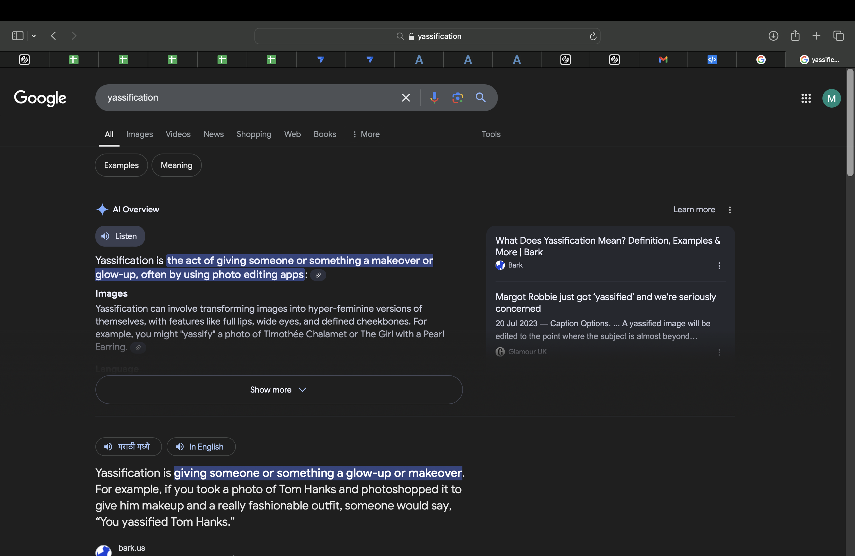

Slide 184
Word of the Year
Demure:
Picture: Image representing "Demure" (e.g., a calm, modest appearance).
Meaning: Refers to someone or something that is reserved, modest, or shy.
Often used to describe modest fashion or behavior.
Popular in discussions of manners or personality traits.
Represents elegance in simplicity and modesty.

Slide 185
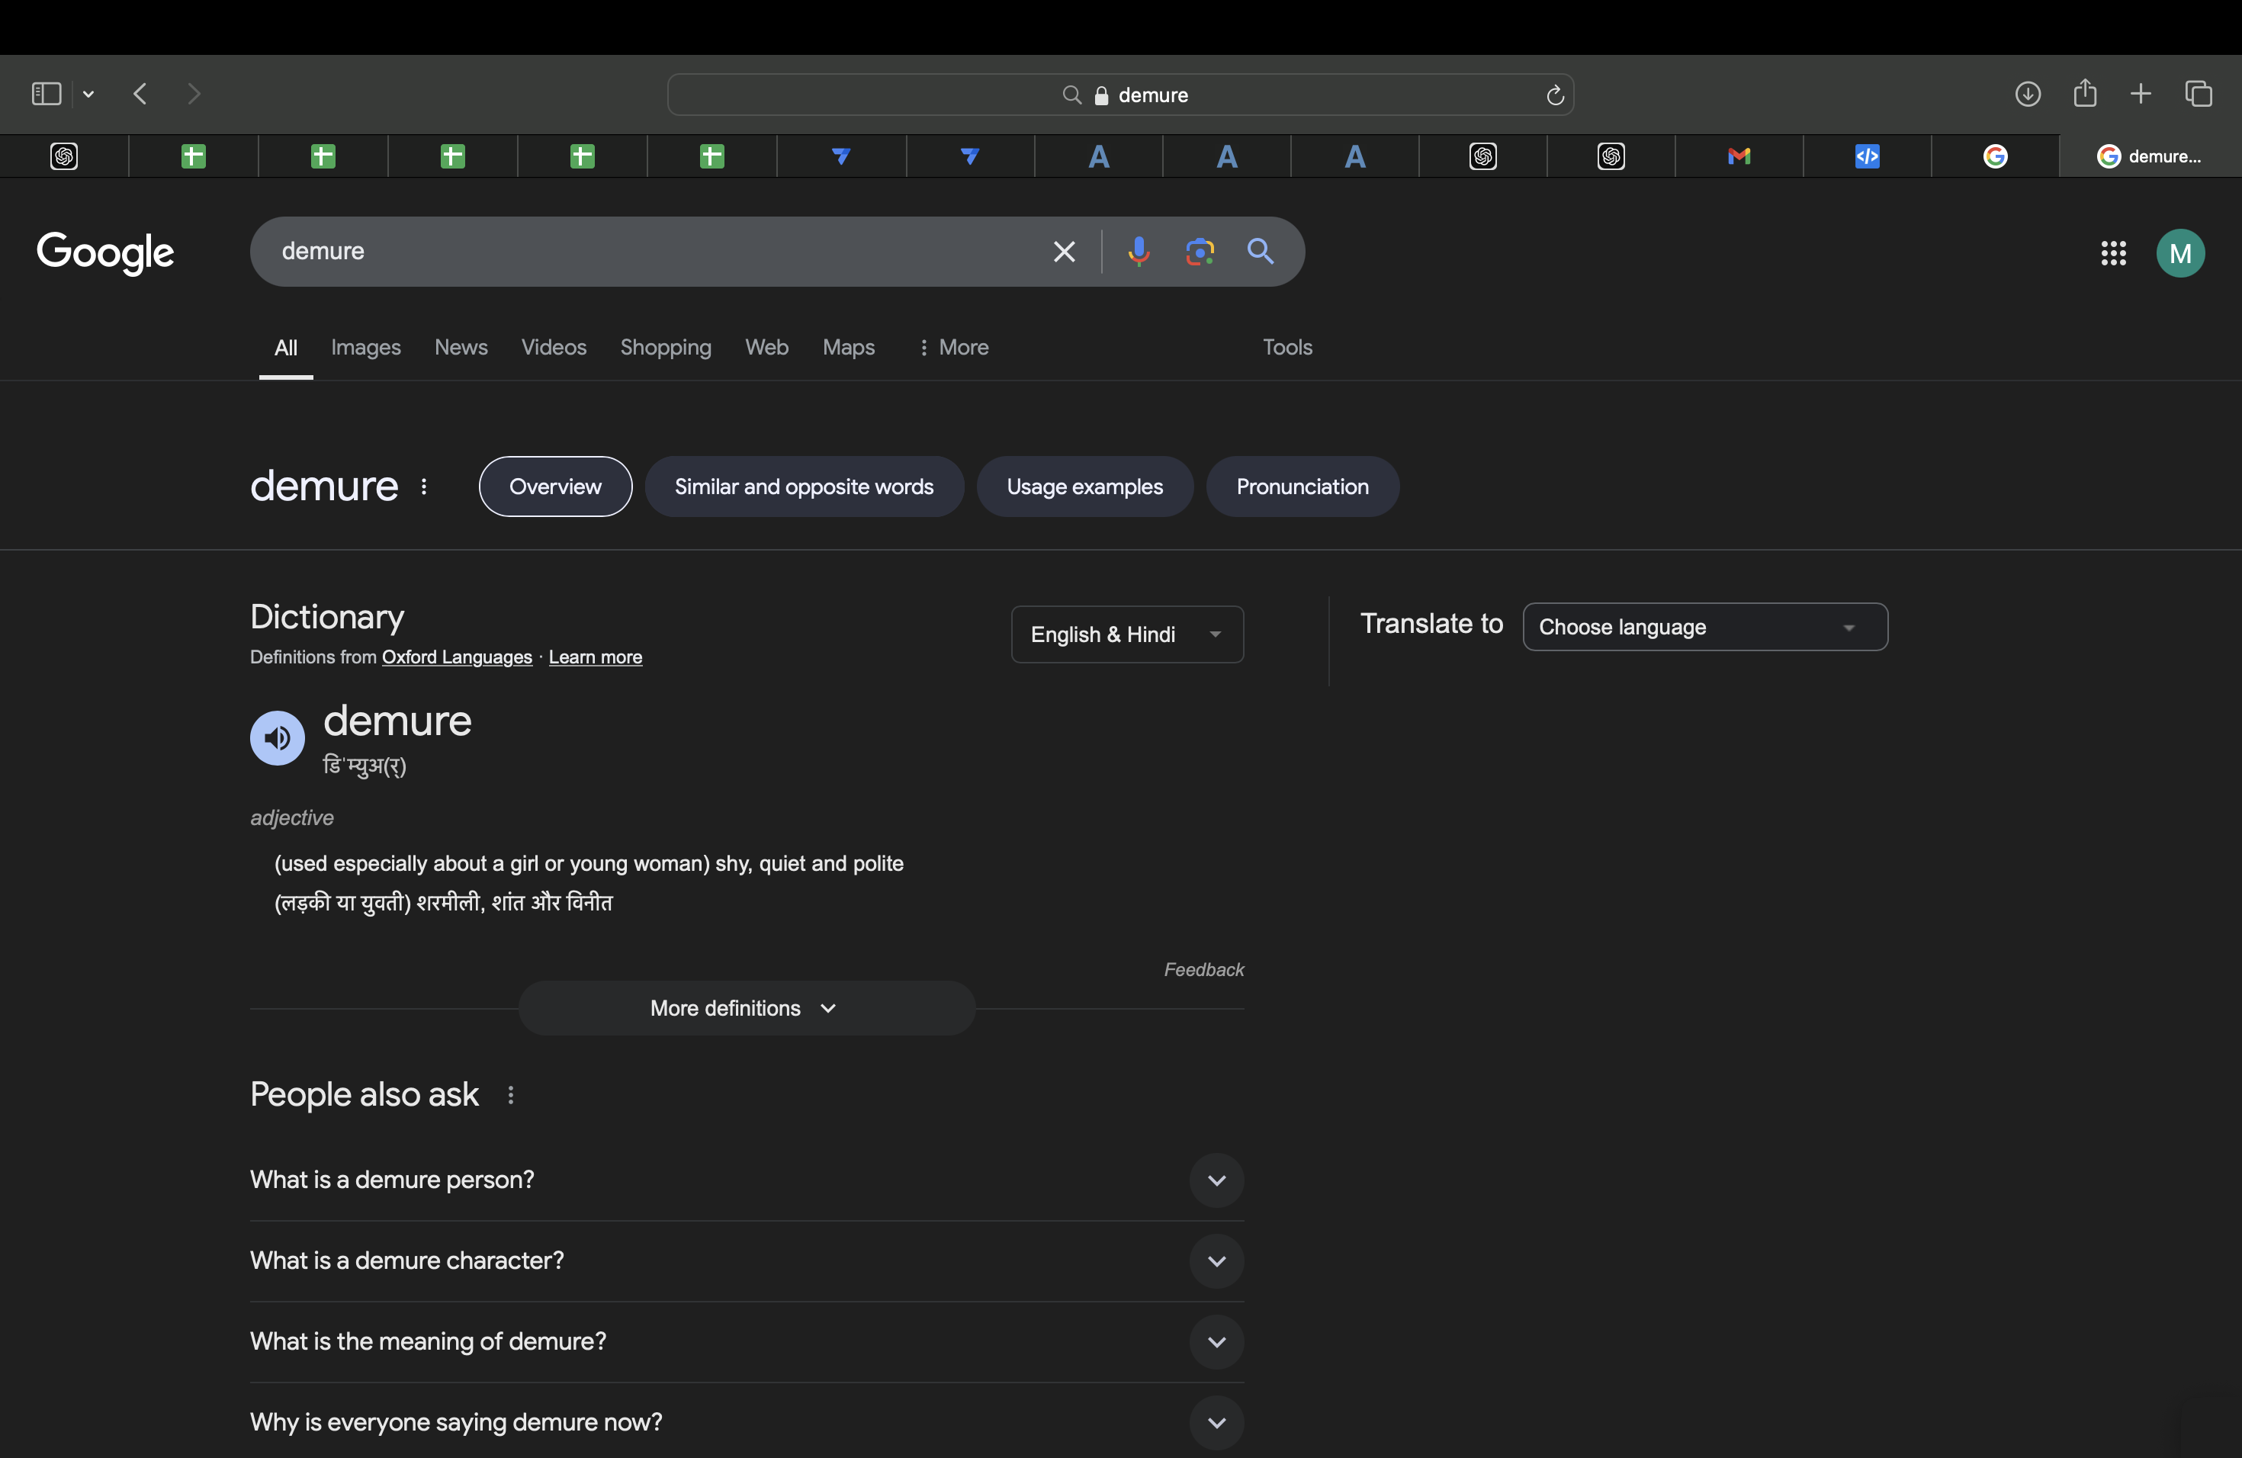

Slide 186
Word of the Year
Mid:
Picture: Image related to "Mid" (e.g., something average or neutral).
Meaning: Used to describe something that is average, not particularly good or bad.
Often used in a critical or ironic tone, especially in pop culture.
Can describe music, movies, or experiences that are unremarkable.

Slide 187
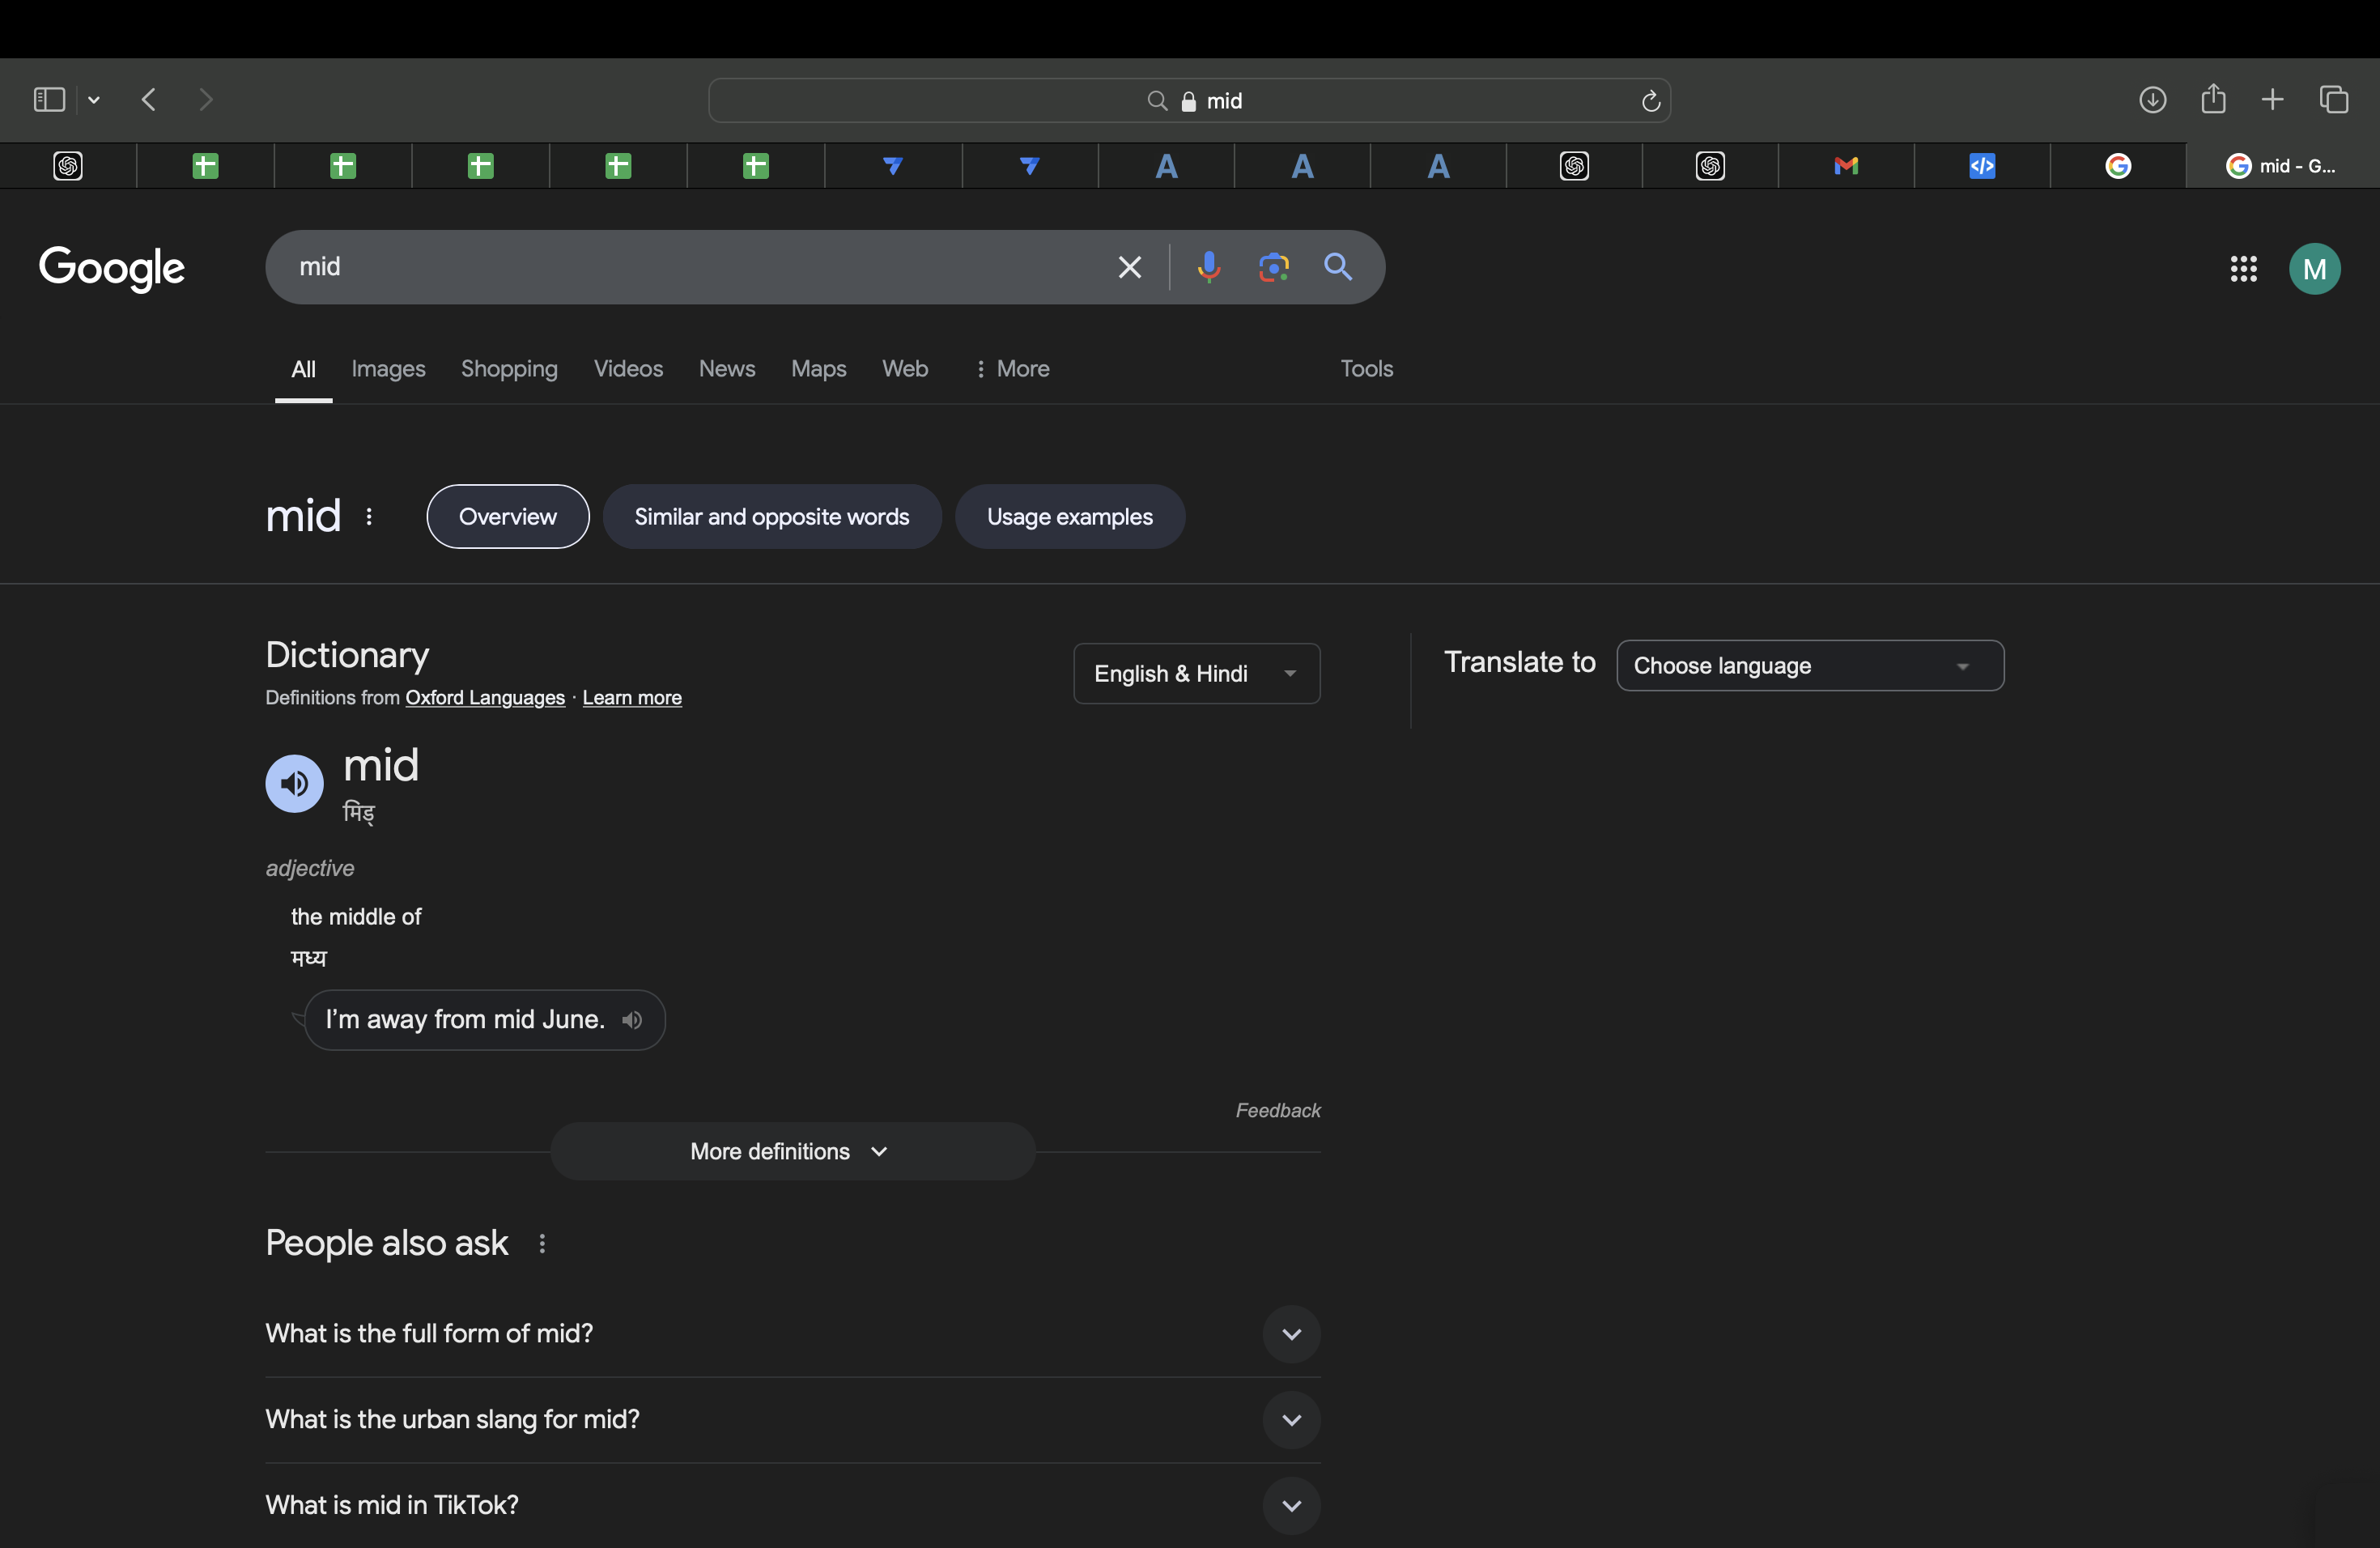

Slide 188
Word of the Year
En-Shittification:
Picture: Image illustrating the concept (e.g., a service or product becoming worse).
Meaning: The process by which a service or platform degrades in quality over time.
Used to describe the decline in quality due to commercialization or greed.
Often applied to social media platforms or businesses that prioritize profit over user experience.

Slide 189
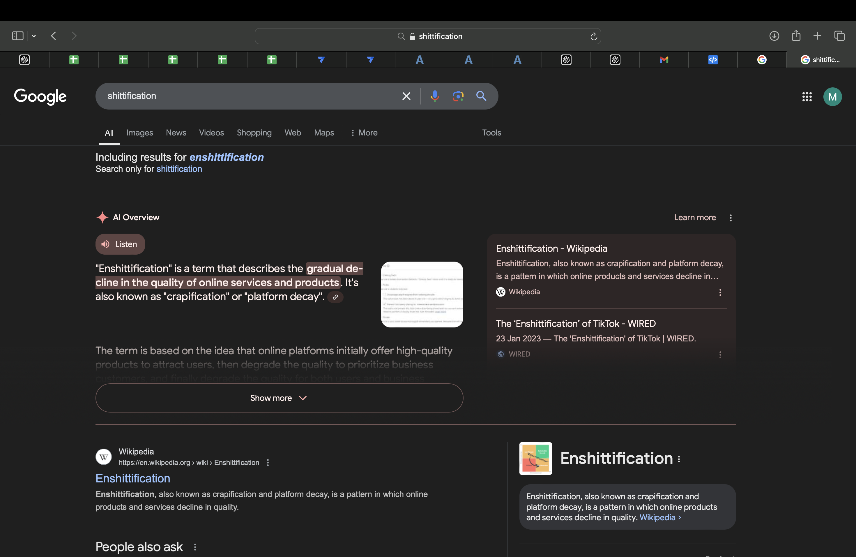

Slide 190
Word of the Year
Brain Rot
Picture: Image representing "Brain Rot" (e.g., someone exhausted by overstimulation).
Meaning: A slang term describing mental exhaustion or deterioration due to excessive consumption of trivial or non-educational content.
Often used to describe the effects of binge-watching or mindless scrolling.
Associated with a feeling of being disconnected from reality after long periods of overstimulation.

Slide 191
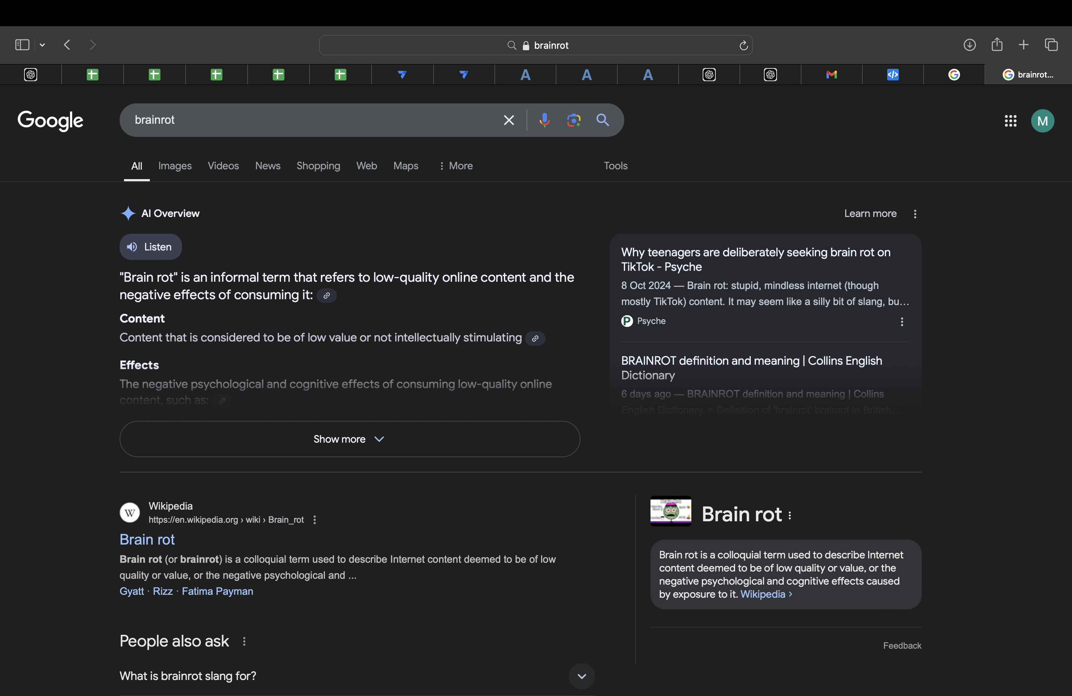

Slide 192
Word of the Year
Delulu
Picture: Image illustrating "Delulu" (e.g., someone daydreaming or overly idealizing a situation).
Meaning: Slang term for being "delusional," particularly in a humorous or playful sense.
Refers to someone who has unrealistic expectations or beliefs, often in romantic or social contexts.

Slide 193
Word of the Year
Delulu
Popular in social media, especially when people idealize relationships or celebrities.
Used in pop culture to describe fans or individuals who ignore reality for a more "idealized" version.
Can be used humorously or self-deprecatingly to describe oneself or others.

Slide 194
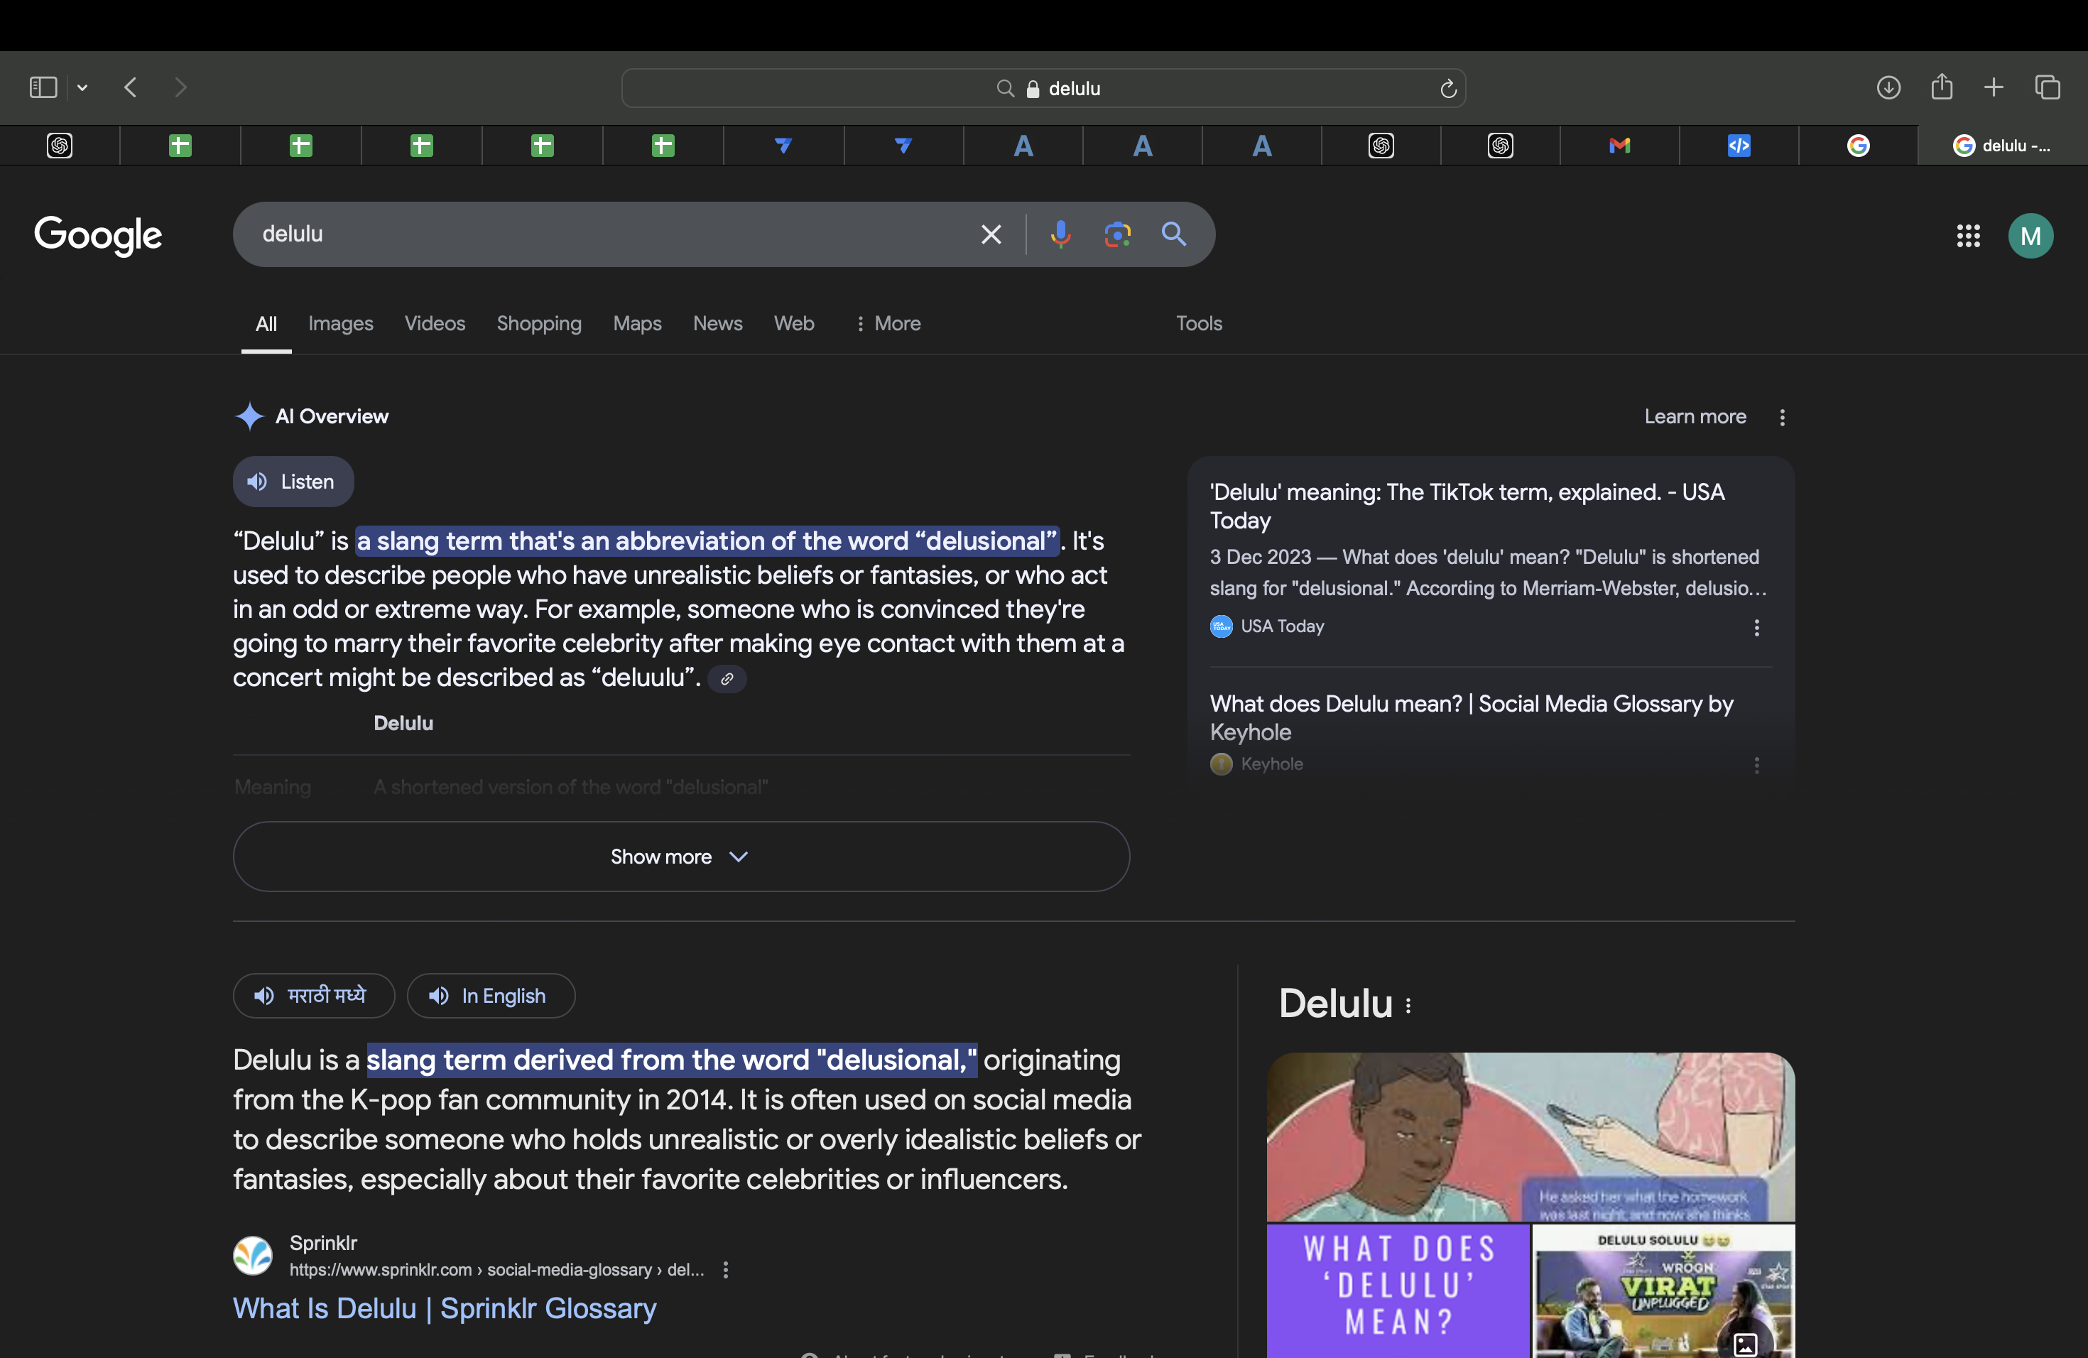

Slide 195
Word of the Year
Manifest
Picture: Image representing "Manifest" (e.g., a vision board or someone writing down goals).
Meaning: The act of bringing something into reality through thoughts, intentions, and beliefs.
Popular in self-help and motivational circles, where people believe that positive thinking attracts good outcomes.

Slide 196
Word of the Year
Manifest
Often linked to the concept of the "Law of Attraction."
Manifesting is about setting clear goals, visualizing success, and taking aligned actions.
Frequently discussed in the context of personal growth, goal-setting, and vision boards.

Slide 197
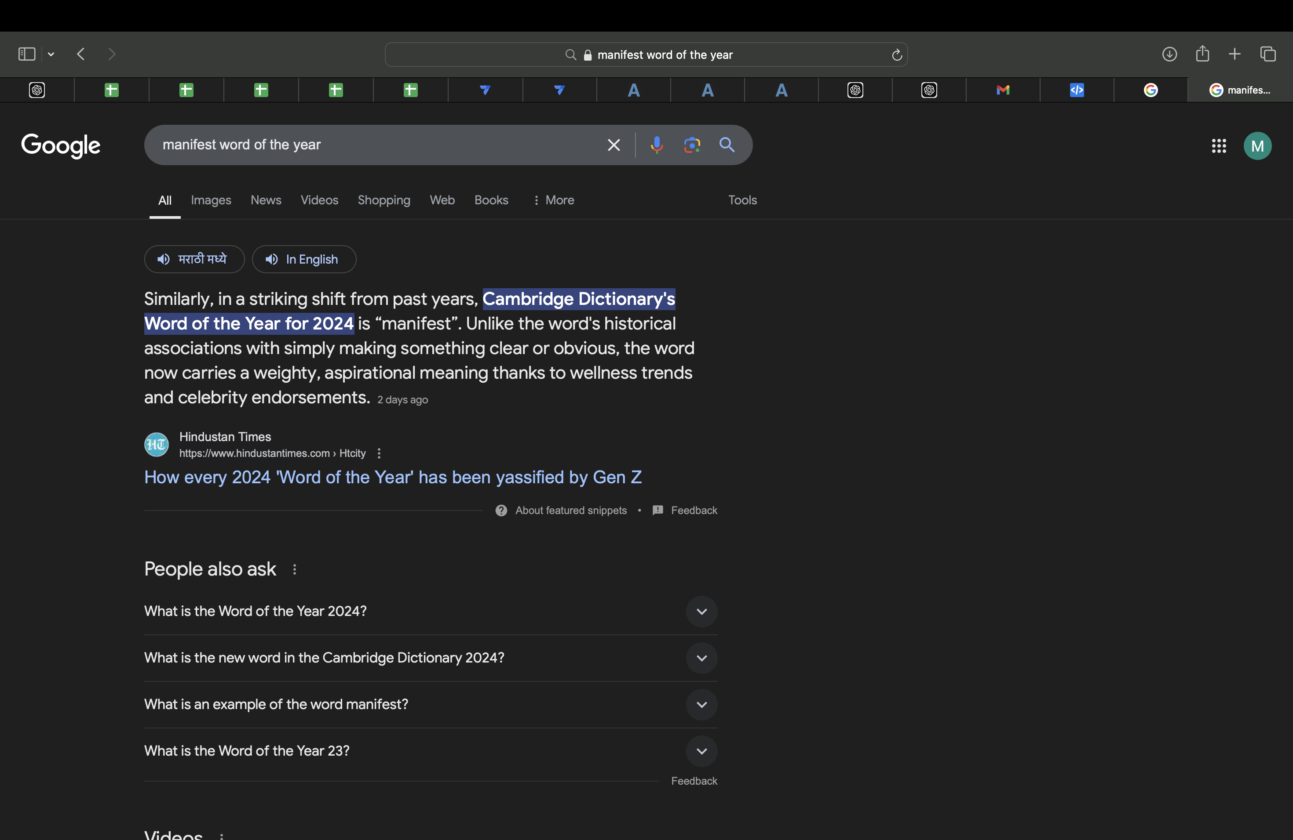

Slide 198
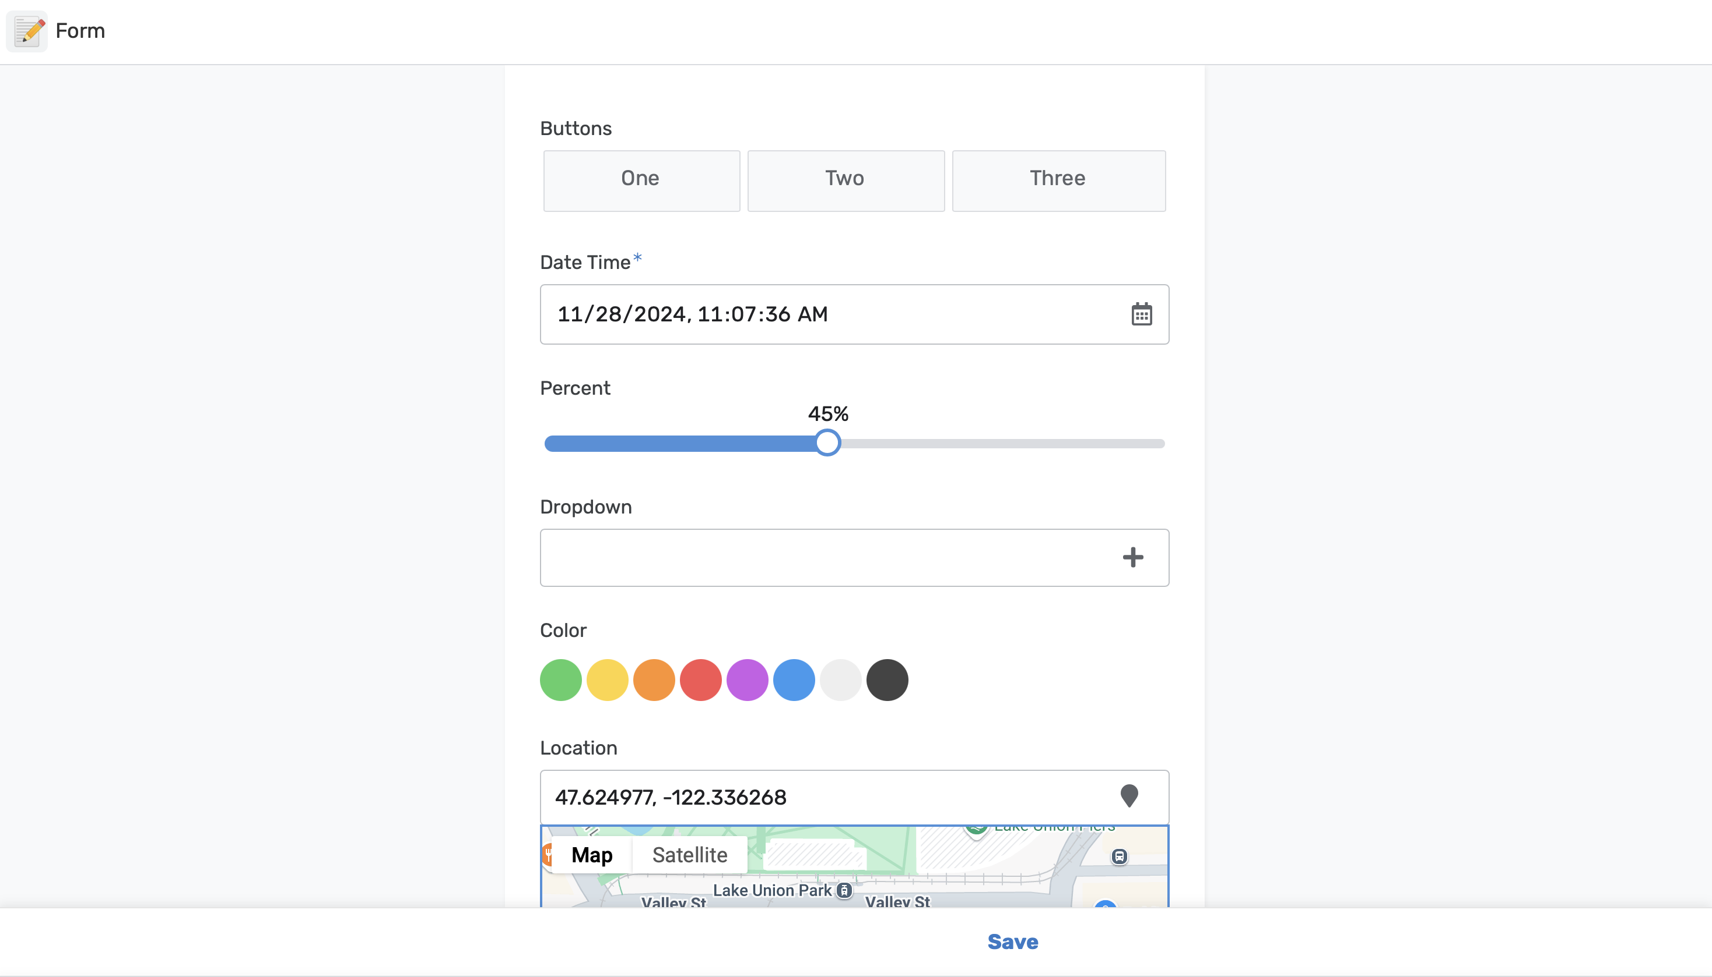

Slide 199


